Slide 1
Introduction to Theology
An Invitation to Theology?
Notes:
Teacher’s Notes Information Page
This notes section is to inform those who would choose to teach this course using the material provided by The Theology Program. Any and all teachers, professors, and pastors are welcome to use the TTP material for the purpose of instructing people in the individual courses or though entire program. It should be noted, however, that each set of notes, PowerPoint presentations, and assignments assumes knowledge of the previous course according to the program schedule (see program schedule on www.thetheologyprogram.com). It is our hope that the TTP material would be of benefit to those whose purpose it is teach people theology at a level greater than that which is readily available though self-study or the typical Bible studies.
PowerPoint Slides and Notes:
The PowerPoint notes provided have the teacher in mind. They are not meant to be an exhaustive source of information on the topic covered. Neither are they meant to answer all of the questions that may come up during the presentation. What we hope to accomplish with the notes section is to give the teacher a basic understanding of what the individual slide is trying to accomplish along with some additional information on the subject of the slide..
The notes will be kept as brief as possible and contain the following types of information:
Explanation of slide: Explanations of what the slide is trying to accomplish. (Most of the time we hope that this is self-evident).
Presentation notes: Expanded subject information including definitions of terms with which we feel the teacher may not be acquainted. Also, there may be suggested illustrations for the topic being discussed.
Activity: Sometimes the slides are created with a particular learning activity in mind and are non-productive without this activity. If this is the case a suggested activity will be explained. Sometime the activities are suggested with and left up to the teacher’s discretion.
References: This will contain both references that were used in the slide and suggested references for further study on the subject.
Illustrations: Whenever possible, we will try to provide a teaching illustration to help the instructor.
Keep in mind that most of the slides are self-explanatory and, therefore, do not need notes. The teacher is expected to have watched the video of the class being taught so that he can get a better idea of what is trying to be accomplished.

Slide 2
“Jesus said to him, ‘Love the Lord your God with all your heart, with all your soul, and with all your mind.’”
–Matthew 22:37
Notes:
Explanation of Slide:
This is simply an introductory slide that may or may not be explained.
You might speak about the importance of knowing God. You cannot love someone unless you know them.
Hopefully, you will have read Love Your God with All Your Mind by J.P. Moreland. This book details much of the philosophy of TTP program and gives us motivation to love God with our mind, as well as understanding of how this is accomplished.

Slide 3
Question Outline
Who are you and why are you here?
What is The Theology Program?
What is theology?
Who is a theologian?
How do we do theology every day?
What are the different categories of theology?
What is the Theological Process?
What is epistemology?
What is postmodernism?
What questions are postmoderns asking?
What is the postmodern view of truth?
What is the modern view of truth?
What is the Christian view of truth?
What truths are relative and what truths are objective?
What truths are essential for orthodoxy?
How certain are you about your beliefs?
What is the essential difference in Roman Catholicism, Eastern Orthodoxy, and Protestantism?
Why are there so many Protestant denominations?
What are the different sources for truth?
What are the benefits and deficiencies of each source?
How do the different sources interact to form our theology?
Does God still speak today?
What is the Continuationist view of prophecy?
What is the Hard Cessationist view of prophecy?
What is the Soft Cessationist view of prophecy?
How do we do theology in our emerging context?
Notes:
Presentation Notes:
These are the twenty-three primary questions that will be addressed in this course. They will serve as an outline for the course.

Slide 4
Course Outline
Introduction to The Theology Program
Defining Theology
Categories of Theology
Postmodern Epistemology
Christian Epistemology
Essentials of Theology
Traditions of Christian Theology
Sources of Theology
Does God Still Speak Today?
Unity and Diversity

Slide 5
Session 1 Introduction to the Theology Program
Defining the “Rules of Engagement”
Notes:
Session Overview:
What is The Theology Program anyway? What is our approach to studying theology? Does TTP take the "we're right, your wrong" approach? Or does it approach theology more peaceably, letting the students make up their own mind? Am I smart enough to take this course? These are all important questions that this first session seeks to answer. This session presents a basic understanding of the importance of the study of theology and the purpose of The Theology Program. The "rules of engagement" will set the stage for all future TTP sessions, arguing that theology is best done with an irenic (peaceable) approach, interacting with Christian doctrine and other belief systems in a gracious manner, allowing the student to make up their own mind when all of the evidence has been accurately presented.

Slide 6
Question
Who are you and why are you here?

Slide 7
Introduction to the Theology Program
Who you are and why you are taking this course?
Notes:
Presentation Notes:
The primary purpose of the following slides is to use humor to put people at ease concerning the rationale for taking this course. While the examples are given comically, they truly are representative of first-time students of TTP.

Slide 8
Introduction to the Theology Program
Practical Pricilla: You are a person who has never seen the practicality in deep theological study. You are here to see if we can change your mind.

Slide 9
Introduction to the Theology Program
Scared Susan: Big words scare you. You don’t really think that you are smart enough to be here. You are here this time, but you may not be here the next.
Notes:
Presentation Notes:
This is the attitude of many. They need to be encouraged, and their fear needs to be taken seriously, since they truly believe that they are not smart and cannot learn at this level.

Slide 10
Introduction to the Theology Program
Know-it-all Nick: You already know everything. You are just here to see if we do… and to pick up where we leave off.
Notes:
Presentation Notes:
This type of person can cause much frustration and take over the entire class if you are not careful. The goal is not to keep him quite, but to challenge him through the conversation of the community.

Slide 11
Introduction to the Theology Program
Fundamental Fred: You are the God-ordained guardian of orthodoxy. You are here to sit, with arms crossed, and protect.
Notes:
Presentation Notes:
This type of person is very set in his ways. He will not open his mind until you help change his way of thinking. We hope to do that in this course.

Slide 12
Introduction to the Theology Program
Want-an-answer Will: You have a lot of questions. You are here not to do theology in community, but to write theology down with a pen and paper.

Slide 13
Introduction to the Theology Program
Traditionalist Teri: You want to learn, but your traditions and preconceived notions bind you. You are here to have your traditions confirmed to be true.

Slide 14
Introduction to the Theology Program
Confrontational Carl: You are not a believer in Christ or the Bible and have no intention of becoming one. You are here to argue.

Slide 15
Introduction to the Theology Program
Struggling Sam: You are a believer in Christ, but you have a lot of doubts and struggles. You have never had a safe place to express those doubts. You are here to see if this is the place.

Slide 16
Introduction to the Theology Program
Curious Carla: You are not really sure why you are here, but you’re excited to find out.

Slide 17
Introduction to the Theology Program
We are all real people created by a real God, and we all have real struggles, real questions, and real convictions.
We are glad that you are here!

Slide 18
Question
What is The Theology Program?

Slide 19
Introduction to the Theology Program
The Theology Program is an intense theological studies program, designed for busy people who may never go to seminary but who want deep theological training. While there are many great subjects, biblical and spiritual, that Christians can and need to study, our focus is on six specific courses of systematic theology. Our desire is to teach people how to think by opening their minds to diverse views, learning from history, wrestling with difficult issues, and graciously engaging an increasingly relativistic and postmodern world.

Slide 20
Introduction to the Theology Program
Mission: Renewing minds and changing lives by purposefully guiding people through a study of historic and biblical Christian theology.
Goal: “Our goal is not so much to teach good theology, as important as that is, but to teach people to think.”

Slide 21
Introduction to The Theology Program
What makes The Theology Program different?
Intensity in studies
Irenic theology
Intentional program design
Comprehensive coverage
Doing theology in community

Slide 22
Intensity in Studies
The Church must have an avenue of intense, interactive Christian education through a program which gives people an opportunity to learn at a level that other venues cannot provide. TTP endeavors to be this avenue.
Notes:
Presentation Notes:
We will use, and expect the student to become aware of, issues in theology and theological terminology that will be new to most. We will not cover issues that amount to academic “busy work” and that are not essential to becoming well informed with issues that impact our spiritual walk with God.

Slide 23
Intensity in Studies
Fellowship/
Sunday School
Sermon
Interactive Classroom
Low Commitment
High Commitment
Notes:
Presentation Notes:
The idea is that the further you move to the left, the less you can count on people’s faithful attendance.

Slide 24
Intensity in Studies
Fellowship/
Sunday School
Sermon
Interactive Classroom
Low Expectations
High Expectations
Attendance
Assigned readings
Books
Papers
Case studies
Memorization of Scripture
Grades

Slide 25
Intensity in Studies
Fellowship/
Sunday School
Sermon
Interactive Classroom
Devotional
(Brings encouragement for the week)
Foundational
(Builds theology for a lifetime)
Notes:
Presentation Notes:
The Sunday sermon can and does contribute to a person’s theology, but this type of teaching and exhortation is limited in what it can actually accomplish in helping people take ownership of their understanding of the Bible and theology.

Slide 26
Intensity in Studies
Fellowship/
Sunday School
Sermon
Interactive Classroom
Short-term life change
Long-term life change
Notes:
Illustration:
In order to demonstrate this, ask people what they learned in last Sunday’s sermon. You don’t necessarily need to have them answer out loud since there will always be one or two people who can recall it to their mind and then seemingly prove your point wrong. Then ask them what they learned last week in teacher training course. They will more than likely be able to recall more of last Saturday’s lesson than Sunday’s sermon.

Slide 27
Intensity in Studies
Fellowship/
Sunday School
Sermon
Interactive Classroom
Exhortation
Education
Notes:
Presentation Notes:
This is often referred to as the “Power of the Pulpit.” People sense more of the immediate presence of God in a passive learning environment such as a Sunday sermon. In these situations, people not able to argue, discuss, or debate the issues are more likely to let God speak directly to them and, therefore, tend to experience more conviction and short-term life change.

Slide 28
Intensity in Studies
Fellowship/
Sunday School
Sermon
Interactive Classroom
The education program of the Church needs to include all of these in balance.
Notes:
Illustration:
Ask your students whether they are receiving all of these types of teaching in their lives. Ask them if they are in balance. Most people rely upon the Sunday sermon to give them all of their spiritual education, when, because of its nature, it can only accomplish a small part.

Slide 29
Irenic Theology
Key Terms
Irenic Theology: Theology that is done peaceably, accurately representing all views, even when you oppose them.
Polemic Theology: Theology that is done in a warlike manner inside the Church, prophetically speaking against those with whom there is disagreement.
Apologetic Theology: Theology that is done to defend the faith against those who oppose outside the church.

Slide 30
Irenic Theology
Irenic
Peace
War
Defense
Polemic
Apologetic
Notes:
Presentation Notes:
We realize that there is a time and a need for each of these methods to be emphasized. The arrows represent the goal of The Theology Program to utilize all methods of doing theology, always beginning with and bent toward our irenic approach. There will be times when we are very polemic in our approach. As well, there will be apologetic elements to all that we do. But this all must be done with an irenic spirit. This evidences our assumption that people, even those with whom we disagree strongly, have reasons for their beliefs, and these reasons need to be examined as objectively as possible. If we are not able to do this, we are not teaching but are indoctrinating.
Ironically, this is also the ancient symbol for the Trinity. How can we go wrong with this approach!
Illustration (1):
The often-used illustration of the counterfeit dollar bill helps people to understand what we are not. The illustration goes like this: Those who deal with money are trained to spot counterfeits. Rather than studying the different types of counterfeits, their training involves studying the real thing. Moral: We should only study good theology so that we can spot bad theology when it crosses our path. Besides the fact that this illustration is not true of bankers, it is really not true of theology. First of all, how does one know what true theology is? You must start with an assumption that dictates the entire process. The assumption is that the theology you have started with (the true dollar bill) is the exact representation of the truth. This is more than any of us can say, since we are all biased by our perspective. We need the community of God to help us continually shape our theology. The dollar bill approach evidences a purely polemic and modernistic Christian mindset. This approach, we hope, is more relevant and persuasive.
Illustration (2)
As well, this can be illustrated in modern American politics. It is very polemical in nature. Neither side ever wants to acknowledge any good on the opposing side, whether in motives or beliefs. The more credible politicians will give due credit to the opposing parties position, while at the same time having strong convictions against them.

Slide 31
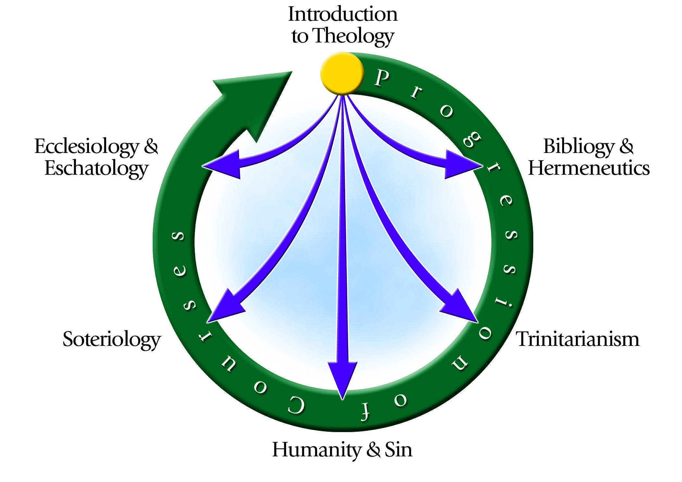
Intentional Program Design
Notes:
Presentation Notes:
This chart describes the progression of courses in The Theology Program. It is suggested that the student take the courses in the suggested order, but this is not a requirement. Introduction to Theology is the prerequisite to all other courses because it gives us the “rules of engagement” for doing theology.
The reason why this is different is because we focus only on these seven courses. Many Bible institutes contain so many courses (albeit good courses) that people don’t know what courses to take. There is no pastor guidance. This program is very intentional in its progression of courses. Each class assumes knowledge of the previous courses. This is the pastoral element to The Theology Program. When the program was designed, we asked ourselves, What is it that the Church needs the most? We saw many good Bible studies going on in many places, but we did not see a place where people could learn to do theology. We did not see a place where people were taught to think. Since the public school system is not doing this, and we did not see any high-quality intention programs available to the Church, we thought that we would do what we could to fill this gap.

Slide 32
Comprehensive Coverage
In the courses, we will address all the relevant major issues, current and historic, of which we think people need to be aware.
Notes:
Presentation Notes:
It is important to note that TTP covers only the relevant issues in historic, systematic, and contemporary theology of which we believe people need to be aware, so that they can be well informed; this makes the program comprehensive.

Slide 33
Doing Theology in a Community
We believe that truth is not found in Spirit-illuminated individuals, but in a community of Spirit-illuminated individuals. Therefore, we believe that the Body of Christ, both alive and dead, must come together to understand theology, shaping it from many perspectives and differing experiences. This is doing theology in a community.
Notes:
Presentation Notes:
People understand things differently depending on their culture, personality, personal history, and their situation in life. Different people will understand things differently and, therefore, will contribute to the community in different ways. If we were to study theology alone, we would be greatly deficient in our understanding and perspective, and we would become unnecessarily bigoted, exclusive, and isolated from the larger Body of Christ.

Slide 34
Notice how the draft is incomplete and erased at places. This illustrates how our theology is never finished in this life, but is always undergoing change and development.
The “T” stands for “Theology” in The Theology Program.
The tablet upon which we construct our theology is broken. This represents an imperfect people, broken by sin, doing our best to understand God in our state of imperfection.
The column represents a pillar, communicating that our theology creates a strong foundation upon which our life, purpose, and actions exist.
Notice how the draft goes outside the lines at times. This represents how our theology, while having a great respect for tradition, must break with tradition at times. This is the Reformers’ principle of semper reformanda (“always reforming”).
Notes:
Presentation Notes:
Explain TTP logo here.

Slide 35
Discussion Groups
Notes:
Activity: Group discussion
Have people separate into groups of 5–10 people to discuss the questions found in the student notes. Make sure that each group has a leader who is familiar with the material and able to keep the discussion on track. The discussion groups should last no longer than 45 minutes.

