Slide 1

Notes:
Presentation Notes

Slide 2

Bible
Mankind
Trinity
Jesus
Faith
Living w/ God
Living w/ the Bible
Living w/ God’s People
Living w/ Pain
Living as Lights

Slide 3


Slide 4


Slide 5


Slide 6


Slide 7

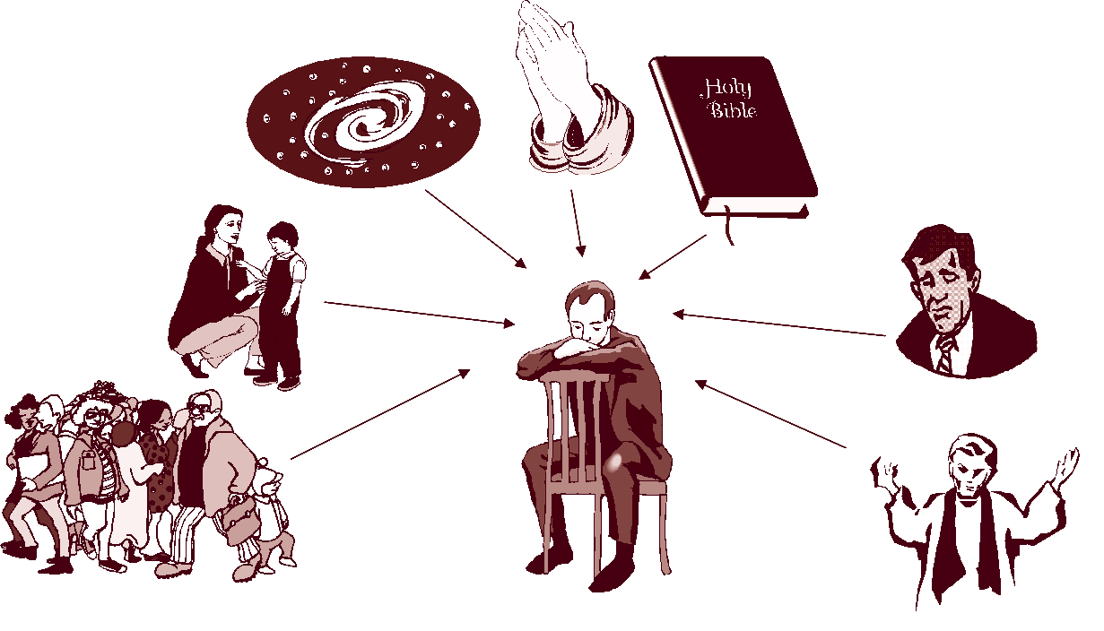

Slide 8
General Introduction to the Bible

Slide 9
Vitals:
Canon: The Bible is a collection of 66 books (Protestant).

Slide 10
Vitals:
Time Period: 1400 B.C. – 100 A.D.

Slide 11
Vitals:
Authors: 40+, from fishermen to kings

Slide 12
Vitals:
Language: Hebrew (most of the Old Testament, Aramaic (small portions of the Old Testament), and Koine Greek (New Testament)

Slide 13
Vitals
The Bible has not been added to in over 2000 years.

Slide 14
“Old” Testament
vs.
“New” Testament

Slide 15


Slide 16

The Bible is the “Word of God”

Slide 17
2 Tim. 3:16–17
“All Scripture is inspired by God and profitable for teaching, for reproof, for correction, for training in righteousness; so that the man of God may be adequate, equipped for every good work.”

Slide 18
Five things this tells us about the Bible:
It is from God
It is to be taught
It reproves and corrects our thinking
It equips us
It does not lack

Slide 19
qeo,pneustoj =
qeo,j (theos) pneustoj (pneustos)
Lit. “God breathed”
Notes:
Presentation notes:
It is important to note that Scripture is the only thing that is said to be “God-breathed”.

Slide 20
The Bible is the word of man

Slide 21
2 Pet. 1:20–21
“But know this first of all, that no prophecy of Scripture is a matter of one's own interpretation, for no prophecy was ever made by an act of human will, but men moved by the Holy Spirit spoke from God.”

Slide 22
fero,menoi (pheromenoi)
Lit: “to carry,” “to bear,” “to guide,” or “to drive along.”
Used of a ship being carried by the wind (Acts 27:17).
Notes:
Presentation notes:
The key issue that needs to be taught from this verse is that inspiration has its first cause in God, not man. Nevertheless, God used man in the inspiration process, guiding him along utilizing his personality, attitude, intentions, situation in life, writing style, and motivation to correctly convey God’s own words.

Slide 23

Illumination
Inspiration
Revelation

Slide 24
sola Scriptura
The Bible is the final and only infallible authority for our faith.

Slide 26
Five primary sources of religious authority:
Bible
Reason
Tradition
Experience
Emotion

Slide 27
Tradition: Religious information that has been handed down to us from various sources.

Slide 28
Examples:
Benefits:
Deficiencies:
Notes:
Presentation Notes:
Examples: History of Christian thought, Creeds, pastor, parents, culture, books, etc.
Benefits: Keeps us from thinking that theology is something that can be done outside of the community, understands that the Spirit works through other people
Deficiencies: Tradition is very fallible in that it often contradicts itself. It is always relative and subjective.

Slide 29
Reason: Information that comes through the human mind’s capacity for logical, rational, and analytic thought.

Slide 30
Examples:
Benefits:
Deficiencies:
Notes:
Presentation Notes:
Examples: Law of non-contradiction, arguments for the existence of God, creation, etc.
Benefits: Available to all people, common ground, apologetic benefits for classical apologetics
Deficiencies: Noetic effects of sin on the mind, is limited, is subjective (although not like that of experience)

Slide 31
Experience: Information that comes through direct encounter, participation, or observation.

Slide 32
Examples:
Benefits:
Deficiencies:
Notes:
Presentation Notes:
Examples: Life’s circumstances, answered prayer, sin, miracles, chance meetings
Benefits: Immediate experience can bring about great encouragement
Deficiencies: Very subjective, can often be misinterpreted

Slide 33
Emotions: Information that comes through subjectively experienced psychological feelings.

Slide 34
Examples:
Benefits:
Deficiencies:
Notes:
Presentation Notes:
Examples: Inner peace after prayer, a deep feeling of regret or guilt, etc.
Benefits: Emotional experience can bring about great encouragement. Emotion can be conformational. It is personal.
Deficiencies: Very subjective; can often lead one away from God’s will; cannot be relied upon, because people can produce emotional experience on their own

Slide 35
Tradition
Reason
Experience
Emotions
Acts 17:11
These Jews were more open-minded than those in
Thessalonica, for they eagerly received the message, examining
the Scriptures carefully every day to see if these things were so.

Slide 36

Notes:
Why is it important to get the wording of Scripture right?

Slide 37

2 Tim. 3:16
“All Scripture is inspired by God and profitable for teaching, for reproof, for correction, and for training in righteousness, that the man of God may be competent, equipped for every good work.”

Slide 38
Revelation 22:18-19
“I warn everyone who hears the words of the prophecy of this book: if anyone adds to them, God will add to him the plagues described in this book, and if anyone takes away from the words of the book of this prophecy, God will take away his share in the tree of life and in the holy city, which are described in this book.”

Slide 39
Rom 1:20
For since the creation of the world God's invisible qualities--his eternal power and divine nature--have been clearly seen, being understood from what has been made, so that men are without excuse.

Slide 40
Acts 17:11
These Jews were more open-minded than those in Thessalonica, for they eagerly received the message, examining the Scriptures carefully every day to see if these things were so.

Slide 41
Phil. 4:7
And the peace of God, which surpasses all understanding, will guard your hearts and your minds in Christ Jesus.

Slide 42
John 16:8
And when he [the Holy Spirit] comes, he will convict the world concerning sin and righteousness and judgment.

Slide 43
Act 4:19-20
But Peter and John replied, “Judge for yourselves whether it is right in God’s sight to obey you rather than God. For we cannot help speaking about what we have seen and heard.”

Slide 44


Slide 45

Has your understanding of the Bible grown?
In what ways do you think emotions could conflict or support the Bible? Give examples?
Why should we trust Scripture over experience? Give examples where experience would support the Bible?
Why is tradition dangerous and wonderful?
If Scripture seems to come in conflict with modern scientific opinion, what should we do? Give examples.

