Slide 1

WELCOME

Slide 2

Church History Boot Camp

Slide 3
Week 1: Early Church (70 – 300)
Week 2: Orthodoxy (300 – 529)
Week 3: The Medieval Church (500 – 1516)
Week 4: The Reformation (1517 – 1650)
Week 5: The Modern Church (1650 – Present)

Slide 5
The Early Church

Slide 6

Philosophy of History

Slide 7
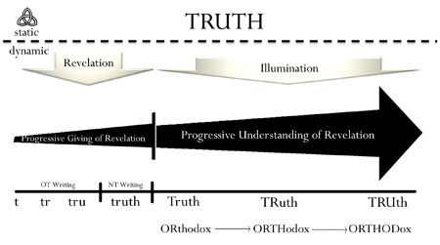
Philosophy of History
Notes:
Presentation Notes:
This illustrates the importance of a proper method of interpretation.

Slide 8
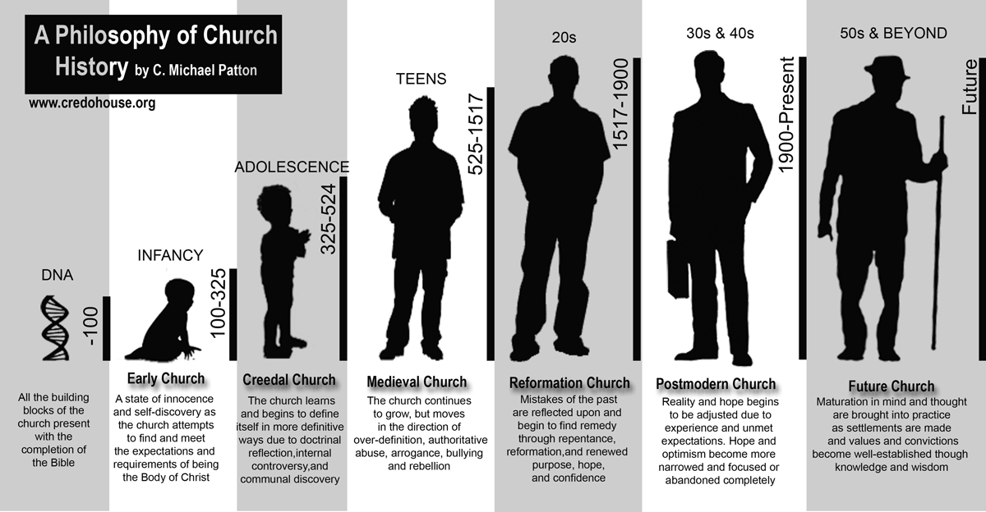
Philosophy of History
Notes:
Presentation Notes:
This illustrates the importance of a proper method of interpretation.

Slide 9

Early Church
Notes:
Presentation Notes:
This illustrates the importance of a proper method of interpretation.

Slide 10
Martyrs
Early Church
Notes:
Presentation Notes:
This illustrates the importance of a proper method of interpretation.

Slide 11
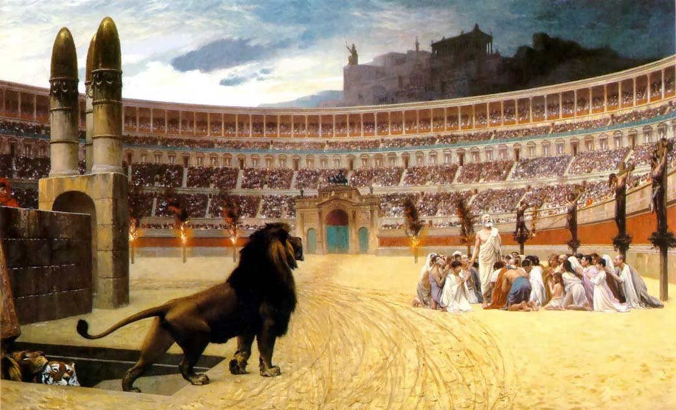
Martyrs
“If you suffer as a Christian, do not be ashamed, but praise God that you bear that name.”
(1 Pet. 4:16)
Early Church
Notes:
Presentation Notes:
This illustrates the importance of a proper method of interpretation.

Slide 12
Martyrs
“The oftener we are mown down by you, the more in number we grow; the blood of Christians is seed.”
- Tertullian (Apology, 50)
Early Church
Notes:
Presentation Notes:
This illustrates the importance of a proper method of interpretation.

Slide 13
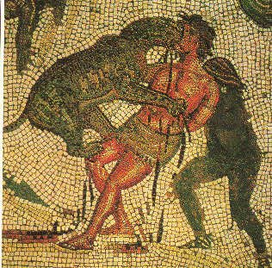
Martyrs
Facts about martyrdom in the early church:
Martyrdom in the early Church was sporadic, spaced sometimes by long periods of relative peace.
Early believers were charged with atheism, cannibalism, and incest.
Persecution often grew out of animosity by the populace rather than from deliberate government policy.
There have been more martyrs in the past 50 years than in the first 300 combined.
Most imperial decrees were directed against church property, the Scriptures, or limited to church leadership.
Christians were blamed for causing natural disasters due to refusing to worship the deities that protected communities.
Early Church
Notes:
Presentation Notes:
It is important to emphasize here that the organic rise of persecution was due to the nationalistic pride that people took in their religious polytheism. But this pride should not be seen as a religious conviction, but more of a social convention. The worship of the gods was a way of life that they were used to and enjoyed. To disturb their religion was to “crash their party” in a sense. Christians came in expressing true devotion and real conviction concerning their faith. This was quite uncommon.

Slide 14
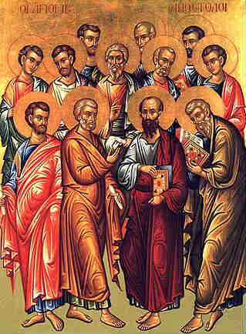
Martyrs
Death of the Apostles
1. James - Killed with a sword. 45 A.D.
2. Peter - Hung on a cross “head downward.” A.D. 64
3. Andrew - Hung from an olive tree. A.D. 70
4. Thomas - Burned alive. A.D. 70
5. Phillip - Crucified. A.D. 54
6. Matthew - Beheaded. A.D. 65
7. Nathanael - Crucified. A.D. 70
8. James - Thrown from the temple. A.D. 63
9. Simon - Crucified. A.D. 74
10. Judas Thaddeus - Beaten with sticks. A.D. 72
11. Matthias - Stoned on a cross. A.D. 70
12. John - Natural death. A.D. 95
13. Paul - Beheaded. A.D. 69
Early Church

Slide 15
Martyrs
“A vast multitude [of Christians], were convicted, not so much of the crime of arson as of hatred of the human race. And in their deaths they were made the subjects of sport; for they were wrapped in the hides of wild beasts and torn to pieces by dogs, or nailed to crosses, or set on fire, and when day declined, were burned to serve for nocturnal lights.“
-Tacitus' Annals XV.44
Early Church

Slide 16
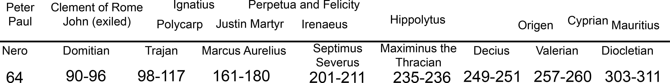
Martyrs
Early Church
Notes:
Presentation Notes:
The primary persecutors are often thought of as the three big D’s: Domitian, Decius, Diocletion (although Nero sometimes gets thrown into the mix). With Decius came the first empire sanctioned persecution of the church. Decius blamed the Christians for the decline of the Roman empire believing that the gods were angry due to its toleration of Christianity. This eventually turned into a desire to completely eradicate Christianity from the empire.

Slide 17
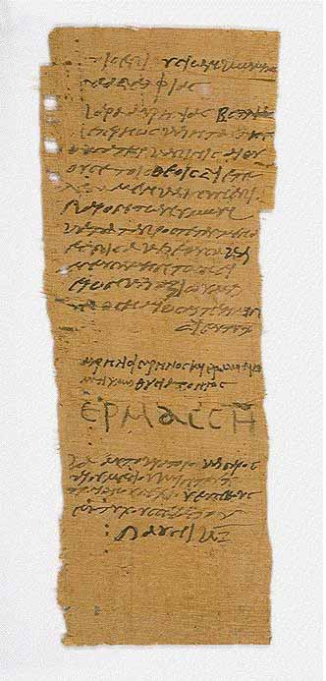
Martyrs
Labellus: A certificate demonstrating that one had made the appropriate sacrifices to the gods of Rome.
Sacrificati: Describes those who had actually offered a sacrifice to the idols. If a Christian made sacrifices and obtained a labellus, they were only offered absolution on their deathbeds.
Libellatici: Describes those who had false labellus created without actually making the sacrafices. A two year sanction was imposed as penance.
Traditores: Describes those who gave up scriptures and/or revealed names of fellow Christians. From Latin tradere - "hand over; deliver; betray”
Early Church

Slide 18
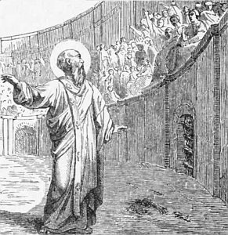
Martyrs
Polycarp
Polycarp was brought before the proconsul, who begged him to have respect for his great age (he was probably nearly 100), saying, “Swear by the genius of Caesar” and denounce “the atheists.” But Polycarp, seeing “the lawless heathen” in the amphitheater, “waved his hands at them, and looked up to heaven with a groan and said, ‘Away with the atheists.’ ” The proconsul persisted, “Swear, and I will release you. Curse Christ.” And Polycarp replied, “Eighty-six years have I served him, and he has done me no wrong; how can I blaspheme my King who saved me?” He was condemned to death and burned alive.
Early Church

Slide 19
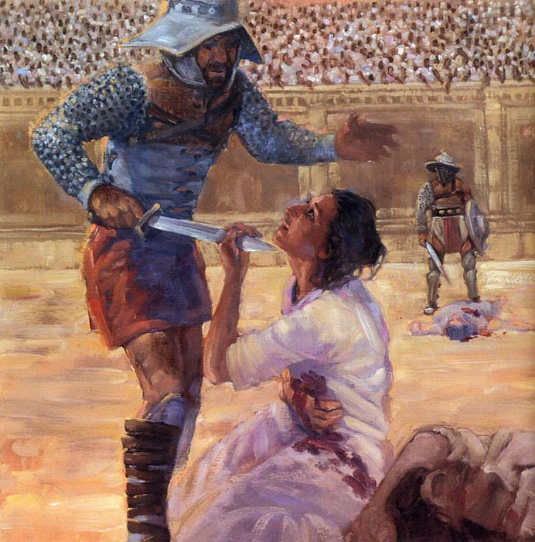
Martyrs
“While” says she, “we were still with the persecutors, and my father, for the sake of his affection for me, was persisting in seeking to turn me away, and to cast me down from the faith,—‘Father,’ said I, ‘do you see, let us say, this vessel lying here to be a little pitcher, or something else?’ And he said, ‘I see it to be so.’ And I replied to him, ‘Can it be called by any other name than what it is?’ And he said, ‘No.’ ‘Neither can I call myself anything else than what I am, a Christian.’ Then my father, provoked at this saying, threw himself upon me, as if he would tear my eyes out. But he only distressed me, and went away overcome by the devil’s arguments. Then, in a few days after I had been without my father, I gave thanks to the Lord; and his absence became a source of consolation to me.
-The Passion of Perpetua and Felicity
Perpetua and Felicity
Early Church
Notes:
Presentation Notes:
The rest of the story: Into the amphitheater
[An observer picks up the story and describes the events of March 7, 203.]
The day of their victory dawned, and they marched from the prison to the amphitheater joyfully, as though they were going to heaven, with calm faces, trembling, if at all, with joy rather than fear. Perpetua went along with shining countenance and calm step, as the beloved of God, as a wife of Christ, putting down everyone’s stare by her own intense gaze.…
They were then led up to the gates, and the men were forced to put on the robes of priests of Saturn, the women the dress of the priestesses of Ceres. But the noble Perpetua strenuously resisted this to the end.
“We came to this of our own free will, that our freedom should not be violated. We agreed to pledge our lives provided that we would do no such thing. You agreed with us to do this.”
Even injustice recognized justice. The military tribune agreed. They were to be brought into the arena just as they were. Perpetua then began to sing a psalm; she was already treading on the head of the Egyptian [dragon?]. Revocatus, Saturninus, and Saturus began to warn the onlooking mob. Then, when they came within sight of Hilarianus, they suggested by their motions and gestures: “You have condemned us, but God will condemn you” was what they were saying.
At this time the crowds became enraged and demanded that they be scourged before a line of gladiators. And they rejoiced at this, that they had obtained a share of the Lord’s sufferings.…
For the young women, however, the Devil had prepared a mad heifer. This was an unusual animal, but it was chosen that their sex might be matched with that of the beast. So they were stripped naked, placed in nets and thus brought out into the arena. Even the crowd was horrified when they saw that one was a delicate young girl and the other was a woman fresh from childbirth with the milk still dripping from her breasts. And so they were brought back again and dressed in unbelted tunics.
First the heifer tossed Perpetua, and she fell on her back. Then sitting up, she pulled down the tunic that was ripped along the side so that it covered her thighs, thinking more of her modesty than of her pain. Next she asked for a pin to fasten her untidy hair; for it was not right that a martyr should die with her hair in disorder, lest she might seem to be in mourning in her hour of triumph.
Then she got up. And seeing that Felicitas [Perpetua’s Christian slave] had been crushed to the ground, she went over to her, gave her her hand, and lifted her up. Then the two stood side by side. But the cruelty of the mob was now appeased, and so they were called back through the Gate of Life.…
Perpetua then called for her brother and spoke to him together with the catechumens and said: “You must all stand fast in the faith and love one another, and do not be weakened by what we have gone through.”
… Immediately as the contest was coming to a close, a leopard was let loose, and [as Saturus predicted,] after one bite Saturus was … drenched in blood.… Shortly afterward, he was thrown unconscious with the rest in the usual spot to have his throat cut. But the mob asked that their bodies be brought out into the open. And so the martyrs got up and went to the spot of their own accord, and kissing one another they sealed their martyrdom with the ritual kiss of peace. The others took the sword in silence and without moving, especially Saturus, who being the first to climb the stairway was the first to die. For once again he was waiting for Perpetual.
Perpetua, however, had yet to taste more pain. She screamed as she was struck on the bone; then she took the trembling hand of the young gladiator and guided it to her throat. It was as though so great a woman could not be dispatched unless she herself were willing.
Ah, most valiant and blessed martyrs! Truly you are called and chosen for the glory of Christ Jesus our Lord! (Christian History Magazine-Issue 27: Persecution in the Early Church. 1990. Carol Stream, IL: Christianity Today.)

Slide 20
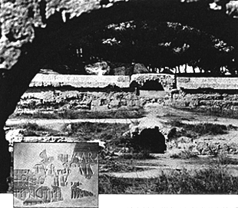
Martyrs
The rest of the story
Perpetua and Felicity’s place of death
Early Church
Notes:
Presentation Notes:
The rest of the story: Into the amphitheater
[An observer picks up the story and describes the events of March 7, 203.]
The day of their victory dawned, and they marched from the prison to the amphitheater joyfully, as though they were going to heaven, with calm faces, trembling, if at all, with joy rather than fear. Perpetua went along with shining countenance and calm step, as the beloved of God, as a wife of Christ, putting down everyone’s stare by her own intense gaze.…
They were then led up to the gates, and the men were forced to put on the robes of priests of Saturn, the women the dress of the priestesses of Ceres. But the noble Perpetua strenuously resisted this to the end.
“We came to this of our own free will, that our freedom should not be violated. We agreed to pledge our lives provided that we would do no such thing. You agreed with us to do this.”
Even injustice recognized justice. The military tribune agreed. They were to be brought into the arena just as they were. Perpetua then began to sing a psalm; she was already treading on the head of the Egyptian [dragon?]. Revocatus, Saturninus, and Saturus began to warn the onlooking mob. Then, when they came within sight of Hilarianus, they suggested by their motions and gestures: “You have condemned us, but God will condemn you” was what they were saying.
At this time the crowds became enraged and demanded that they be scourged before a line of gladiators. And they rejoiced at this, that they had obtained a share of the Lord’s sufferings.…
For the young women, however, the Devil had prepared a mad heifer. This was an unusual animal, but it was chosen that their sex might be matched with that of the beast. So they were stripped naked, placed in nets and thus brought out into the arena. Even the crowd was horrified when they saw that one was a delicate young girl and the other was a woman fresh from childbirth with the milk still dripping from her breasts. And so they were brought back again and dressed in unbelted tunics.
First the heifer tossed Perpetua, and she fell on her back. Then sitting up, she pulled down the tunic that was ripped along the side so that it covered her thighs, thinking more of her modesty than of her pain. Next she asked for a pin to fasten her untidy hair; for it was not right that a martyr should die with her hair in disorder, lest she might seem to be in mourning in her hour of triumph.
Then she got up. And seeing that Felicitas [Perpetua’s Christian slave] had been crushed to the ground, she went over to her, gave her her hand, and lifted her up. Then the two stood side by side. But the cruelty of the mob was now appeased, and so they were called back through the Gate of Life.…
Perpetua then called for her brother and spoke to him together with the catechumens and said: “You must all stand fast in the faith and love one another, and do not be weakened by what we have gone through.”
… Immediately as the contest was coming to a close, a leopard was let loose, and [as Saturus predicted,] after one bite Saturus was … drenched in blood.… Shortly afterward, he was thrown unconscious with the rest in the usual spot to have his throat cut. But the mob asked that their bodies be brought out into the open. And so the martyrs got up and went to the spot of their own accord, and kissing one another they sealed their martyrdom with the ritual kiss of peace. The others took the sword in silence and without moving, especially Saturus, who being the first to climb the stairway was the first to die. For once again he was waiting for Perpetual.
Perpetua, however, had yet to taste more pain. She screamed as she was struck on the bone; then she took the trembling hand of the young gladiator and guided it to her throat. It was as though so great a woman could not be dispatched unless she herself were willing.
Ah, most valiant and blessed martyrs! Truly you are called and chosen for the glory of Christ Jesus our Lord! (Christian History Magazine-Issue 27: Persecution in the Early Church. 1990. Carol Stream, IL: Christianity Today.)

Slide 21
Martyrs
“We ourselves beheld, when we were at these places, many all at once in a single day, some of whom suffered beheading, others punishment by fire, so that the murderous axe was dulled, and worn out, was broken in pieces, and the executioners grew utterly weary.… It was then that we observed a most marvelous eagerness and a truly divine power and zeal in those who placed their faith in the Christ of God. Thus, as soon as sentence was given against the first, some from one quarter and others from another would leap up to the tribunal before the judge and confess themselves Christians.”
-Eusebius of Caesarea
Early Church

Slide 22
Martyrs
Popular opinion about Christianity began to change in the late third century as people witnessed the steadfast commitment of Christians to die for their faith.
Early Church

Slide 23
Apostolic Fathers
Early Church

Slide 24
Apostolic Fathers
Name | Dates | Place | Works | Facts
Clement of Rome | c.30 – c. 100 | Rome | 1 Clement | Possibly knew Paul and Peter Considered to be the forth Pope.
Ignatius | d. 117 | Antioch | Ephesians Magnesians Trallians Romans Philadelphians Smyrnaeans To Polycarp | Letters written in route to martyrdom Opposed gnosticism
Shepherd of Hermas | Late 1st century | Rome | The Shepherd | Wrote in visions and parables
Barnabas | Late 1st century | Alexandria | Epistle of Barnabas | Wrote in allegory
Papias | c. 60 – c. 130 | Hierapolis | Exposition of the Oracles of Our Lord | Knew John Was premillenial Claimed Mark’s Gospel was from Peter
Polycarp | c. 69 – 160 | Smyrna | Philippians | Knew John
Early Church

Slide 25
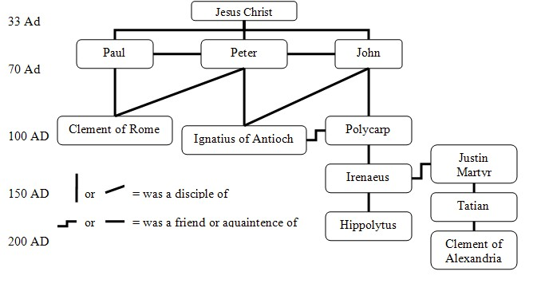
Apostolic Fathers
Early Church

Slide 26
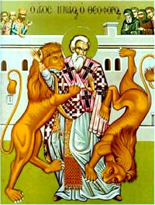
Apostolic Fathers
“And in proportion as a man seeth that his bishop is silent, let him fear him the more. For every one whom the Master of the household sendeth to be steward over His own house, we ought so to receive as Him that sent him. Plainly therefore we ought to regard the bishop as the Lord Himself.”
(Polycarp, Ephesians 6:1)
Early Church

Slide 27
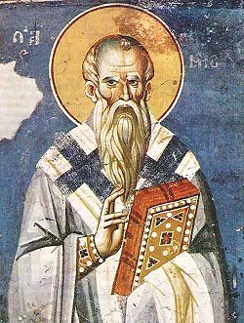
Apostolic Fathers
“Let us fear the Lord Jesus [Christ], whose blood was given for us. Let us reverence our rulers; let us honor our elders; let us instruct our young men in the lesson of the fear of God. Let us guide our women toward that which is good: let them show forth their lovely disposition of purity; let them prove their sincere affection of gentleness; let them make manifest the moderation of their tongue through their silence; let them show their love, not in factious preferences but without partiality towards all them that fear God, in holiness. Let our children be partakers of the instruction which is in Christ. Let them learn how lowliness of mind prevaileth with God, what power chaste love hath with God, how the fear of Him is good and great and saveth all them that walk therein in a pure mind with holiness.”
(Clement of Rome, Corinthians 21:6-8)
Early Church

Slide 28
Apostolic Fathers
Didache 7
“And concerning baptism, baptize this way: Having first said all these things, baptize into the name of the Father, and of the Son, and of the Holy Spirit, in living water. But if you have no living water, baptize into other water; and if you cannot do so in cold water, do so in warm. But if you have neither, pour out water three times upon the head into the name of Father and Son and Holy Spirit. But before the baptism let the baptizer fast, and the baptized, and whoever else can; but you shall order the baptized to fast one or two days before.”
Early Church

Slide 29
Faith
Early Church

Slide 30
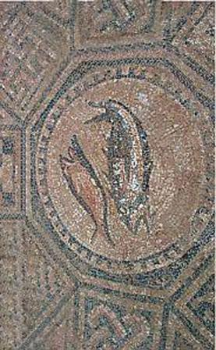
Faith
Facts about faith in the early church:
Most of the leaders were pastoral.
Most elements of faith were in “seed form”.
Much time was spend trying to give a defense of Christian behavior to political leaders.
Practical leadership was the primary concern.
Establishment of the “Rule of Faith”
Catechumen (new converts) were expected to go through three years of training before being baptized.
Early Church

Slide 31
Faith
“Let me compare the catechizing to a building. Unless we methodically bind and joint the whole structure together, we shall have leaks and dry rot, and all our previous exertions will be wasted.”
-Cyril of Jerusalem, Prochatechesis 11
Early Church

Slide 32
Gnosticism
True God
Spiritual
Good
Christ
Emanations
Physical
Evil
Evil Demiurge

Slide 33
Faith
Monasticism:
Gk. monachos, “to be alone”
Early church practice of separating from the world in order to live a holy life, devoted to God.
    Food
    Alcohol
    Marriage/Sex
    Fellowship
    Speaking
Early Church

Slide 34
Faith
Apostles’ Creed
I believe in God, the Father almighty, creator of heaven.
I believe in Jesus Christ, his only Son, our Lord.
He was conceived by the power of the Holy Spirit and born of the Virgin Mary.
He suffered under Pontius Pilate, was crucified, died, and was buried.
He descended to the dead. On the third day he rose again.
He ascended into heaven and is seated at the right hand of the Father.
He will come again to judge the living and the dead.
I believe in the Holy Spirit.
The holy catholic Church, the communion of saints, the forgiveness of sins, the resurrection of the body, and life everlasting.
Amen
Early Church

Slide 35

Field Ops

Slide 36
Martyrs
How is it that the death of the Apostles provides a unique “seed” or witness to the truths of Christianity?
How does the fact that the inception of Christianity is filled with martyrdom effect your view of God?
In what ways is gnosticism still present in the church today?
Considering most churches have a four week membership class when someone becomes a believer, discuss the strengths and weakness of having a three year initiation into Christianity?
Early Church

Slide 37


Slide 38


Slide 39
Orthodoxy

Slide 41


Slide 43
Edict of Milan
Notes:
Presentation Notes:
This illustrates the importance of a proper method of interpretation.

Slide 44
Roman Tetrarchy
East
West
Galerius
Severus
Constantine
Maxintius
Edict of Milan
Notes:
Presentation Notes:
When Constantine’s dad died, since there was no formal arrangement of succession, it was not a guarantee that Constantine would be proclaimed emperor. However, the army did proclaim him emporer. Yet Maxintius also proclaimed himself emperor in Rome. He did not have the support of Galerius, the primary emperor in the East (and senior emperor of the empire). Galarius thought of him as a usurper. Eventually Galerius sent his co-emperor, Severus, to counter Maxintius. Maxintius captured and killed Severus (307). Galerius also unsuccessfully attempted to end Maxintius’ reign, but could not take Rome. Constantine kept his distance from these conflicts for a time.

Slide 45
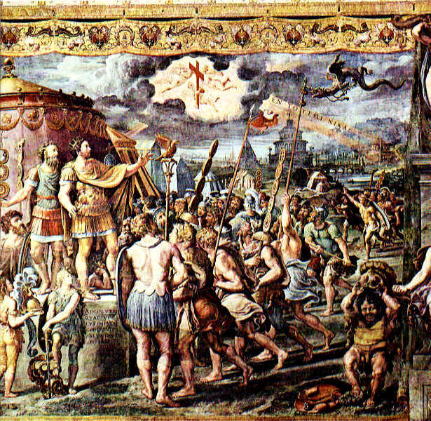
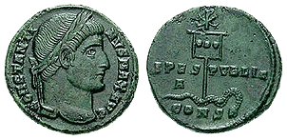

Edict of Milan
Notes:
Presentation Notes:
When Constantine himself entered into the conflict to oust Maxintius, it is said that on Oct 27, 312, Constantine had a vision of a cross in the sky (often depicted as a Chi Rho, the first two letter of Christ’s name in the Greek alphabet). From this vision came a voice saying en touto nika, meaning “in this [sign] conquer. As the story goes, Constantine used this sign (labarum?) as a military standard and went to battle.

Slide 46
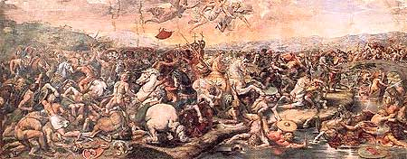
Battle of the Milvian Bridge, fresco by Raphael in the Vatican Palace
Edict of Milan
Notes:
Presentation Notes:
Following Constantine’s “vision of the cross” he faced Maxintius in Rome. Previously, Maxintius had been able to hold off the invasion of Galerius by barricading himself in Rome. However, for reasons unknown (some say a miracle of God some say magic) he decided to meet Constantine head on. This is know as the battle of Milvian Bridge. Maxintius destroyed part of the bridge to prevent Constantine from crossing, then built a temporary bridge or barge for his own army. However, Constantine’s army proved to formatable and backed Maxintius into the Tiber. When Maxintius and his troops finally decided to retreat back to the safety of Rome, they found themselves on an unsturdy bridge (which some believe was built to collapse if Constantine’s army tried to cross). The bridge gave away and Maxintius drown and his army was defeated. The Western empire was united under Constantine.

Slide 47
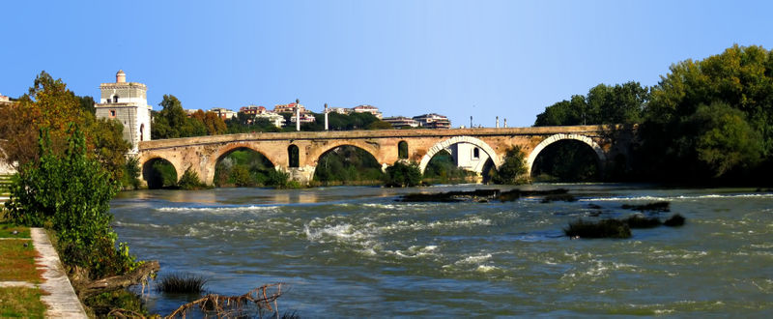
Milvian Bridge, 2005
Edict of Milan

Slide 48
Roman Emperors 313
East
West
Galerius
Severus
Constantine
Maxintius
Licinius
Edict of Milan
Notes:
Presentation Notes:

Slide 49
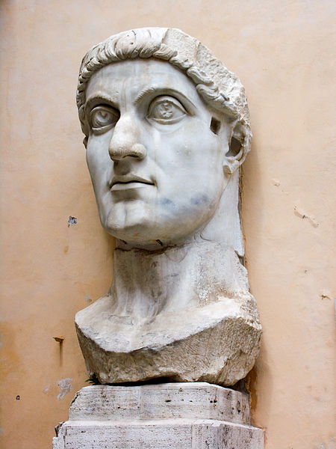
Edict of Milan
Edict agreed upon by Emperors Constantine and Licinius which legalized Christianity, granting them restitution of lands and property.
Edict of Milan
Notes:
Presentation Notes:
“The emperors agreed on the so-called Edict of Milan, officially granting full tolerance to Christianity and all religions in the Empire.The document had special benefits for Christians, legalizing their religion and granting them restoration for all property seized during Diocletian's persecution. It repudiates past methods of religious coercion and used only general terms to refer to the divine sphere — "Divinity" and "Supreme Divinity", summa divinitas.” (Wikipedia)

Slide 50
“We . . . grant to the Christians and others full authority to observe that religion which each preferred.”
-Constantine and Licinius
Edict of Milan
Notes:
Presentation Notes:

Slide 51
Council of Nicea 325
Notes:
Presentation Notes:
This illustrates the importance of a proper method of interpretation.

Slide 52
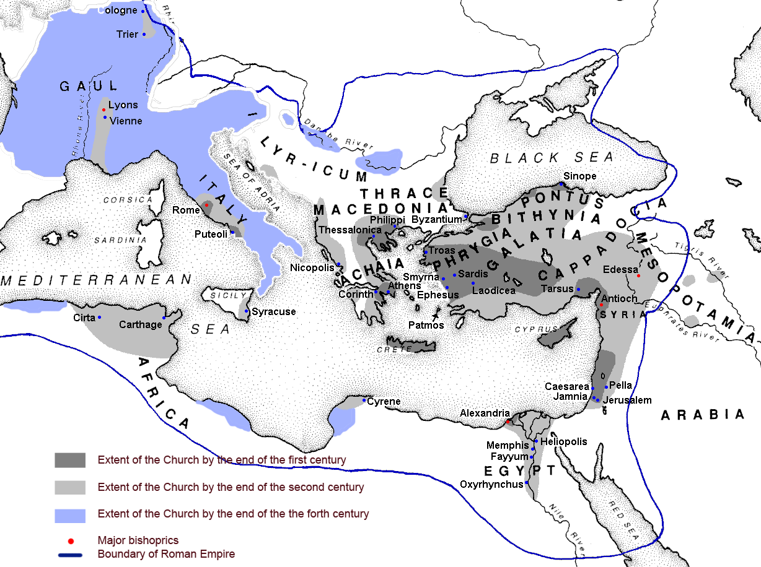
Peace
Early Church

Slide 53
Roman Emperors 324
East
West
Galerius
Severus
Constantine
Maxintius
Licinius
Council of Nicea
Notes:
Presentation Notes:

Slide 54
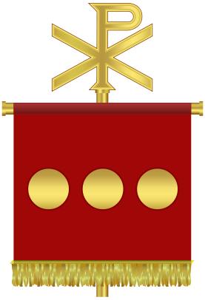
Council of Nicea
Notes:
Presentation Notes:
In the year 320, Licinius reneged on his toleration for Christians, hoping once again to restore to Rome the glories of the former religion. For the first time the perception of the conflict was that of the Christian God against the Roman gods. “Constantine's army emerged victorious in the Battle of Adrianople. Licinius fled across the Bosphorus and appointed Martius Martinianus, the commander of his bodyguard, as Caesar, but Constantine next won the Battle of the Hellespont, and finally the Battle of Chrysopolis on 18 September 324. Licinius and Martinianus surrendered to Constantine at Nicomedia on the promise their lives would be spared: they were sent to live as private citizens in Thessalonica and Cappadocia respectively, but in 325 Constantine accused Licinius of plotting against him and had them both arrested and hanged; Licinius's son (the son of Constantine's half-sister) was also eradicated. Thus Constantine became the sole emperor of the Roman Empire.” (Wikipedia)

Slide 55
Roman Emperors 324
East/West
Galerius
Severus
Constantine
Maxintius
Licinius
Council of Nicea
Notes:
Presentation Notes:
Licinius reneged on the Edict of Milan, turning once again to the gods of Rome. Constantine fought under the Chi Rho.

Slide 56
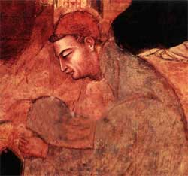
Arius:
Believed that Christ is not eternally God but a creation of God the Father, having his genesis/“begotteness” in eternity past. He is the first created being.
Council of Nicea
Notes:
Presentation Notes:

Slide 57
“If the Father begat the son, he that was begotten had a beginning of existence; hence it is clear that there was a time when the son was not.”
-Arius
Council of Nicea
Notes:
Presentation Notes:

Slide 58

The uncreated God has made the Son
A beginning of things created,
And by adoption has God made the Son
Into an advancement of himself.
Yet the Son’s substance is
Removed from the substance of the Father:
The Son is not equal to the Father,
Nor does he share the same substance.
God is the all-wise Father,
And the Son is the teacher of his mysteries.
The members of the Holy Trinity
Share unequal glories.
Council of Nicea
Notes:
Presentation Notes:

Slide 59
Eternity Past
Time
God
Christ
All other Creatures
Council of Nicea

Slide 60
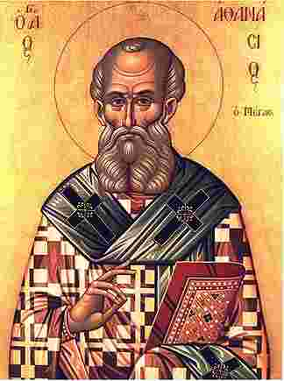
Athanasius:
298 – 373
Bishop (Pope) of Alexandria for 45 years, 17 of which were spend in five exiles due to the instigation of four emperors. He is best known for his stance against Arianism as an ardent defender of the Trinity.
Council of Nicea

Slide 61
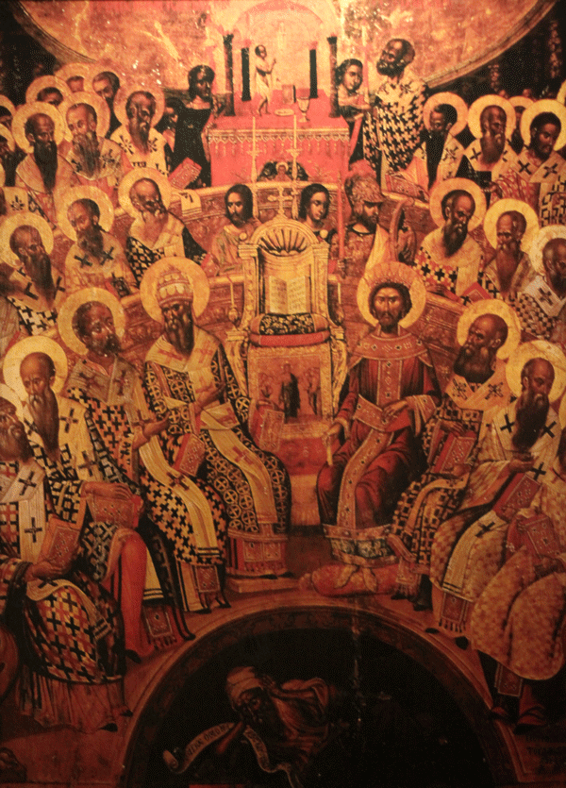
Council of Nicea
325
The first “Ecumenical Council”, called by Emperor Constantine to solve the religious division of the empire brought about by the Arian controversy.
Council of Nicea
Notes:
Presentation Notes:
This illustrates the importance of a proper method of interpretation.

Slide 62
Does it make one iota of difference?
i
Nicea | o`moousioj homoousios
Arius | o`moiousioj homoiousios
Council of Nicea

Slide 63
Nicene Creed
We believe in one God, the Father, the Almighty [pantokratora], creator of all that is seen and unseen. We believe in one Lord, Jesus Christ, the only Son of God, eternally begotten [pro panton ton aionon] of the Father, God from God, Light from Light, true God from true God, begotten, not made, of the same essence [homoousion] with the Father.
Council of Nicea

Slide 64
Nicene Creed
Through him all things were made. For us and for our salvation he came down from heaven: by the power of the Holy Spirit he became incarnate from the Virgin Mary, and was made man. For our sake he was crucified under Pontius Pilate; he suffered death and was buried. On the third day he rose again in accordance with the Scriptures; he ascended into heaven and is seated at the right hand of the Father.
Council of Nicea

Slide 65
Nicene Creed
He will come again in glory to judge the living and the dead, and his kingdom will have no end. We believe in the Holy Spirit, the Lord, the giver of life, who proceeds from the Father and the Son. With the Father and the Son he is worshiped and glorified. He has spoken through the Prophets. We believe in one holy catholic and apostolic Church. We acknowledge one baptism for the forgiveness of sins. We look for the resurrection of the dead, and the life of the world to come. Amen.
Council of Nicea

Slide 66
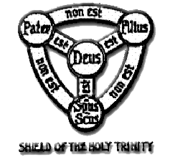
Wrong
Wrong
Right
Council of Nicea

Slide 67
Fables about Nicea
It is illegitimate because it was called by a civil authority.
The doctrine of the Trinity was invented then.
Constantine forced the bishops to agree.
It was a close vote.
Council of Nicea

Slide 68
“The Nicene Creed has remained for nearly seventeen centuries a secure foundation for the church’s theology, worship and prayer. Not only does it succinctly summarize the facts of biblical revelation, but it also stands as a bulwark against the persistent human tendency to prefer logical deductions concerning what God must be like and how he must act to the lived realities of God’s self-disclosure.”
-Mark Noll
Council of Nicea
Notes:
Reference:
Turning Points, 59

Slide 69
Council of Chalcedon 451
Notes:
Presentation Notes:
This illustrates the importance of a proper method of interpretation.

Slide 70
Now that we know that Christ was fully God, what does it mean that he is man?
Chalcedon

Slide 71
John 1:14
And the Word became flesh, and dwelt among us.
1 John 4:2
“By this you know the Spirit of God: every spirit that confesses that Jesus Christ has come in the flesh is from God.”
Chalcedon

Slide 72
Early Christological heterodoxy:
Apollinarianism
Nestorianism
Monophysitism
Chalcedon

Slide 73
Apollinarianism:
Christ was God who took on a human body without a human mind. The divine mind took the place of what would have been the human mind. The Word became flesh only in the sense that God took on a human body. As some have termed it, Christ was “God in a bod.”
Chalcedon

Slide 74
Divine Logos
Human Mind
Human Body
Chalcedon

Slide 75
What is wrong with Apollinarianism?
Chalcedon

Slide 76
“What God has
not assumed is not saved.”
—Gregory of Nazianzus
Chalcedon

Slide 77
Nestorianism:
Christ was fully man and fully God, and these two natures were united in purpose, not person. They had difficulty understanding how someone with two natures could be a single individual.
Chalcedon

Slide 78
Separate
Human Person
Divine Person
Chalcedon

Slide 79
What is wrong with Nestorianism?
Chalcedon

Slide 80
Monophysitism:
Christ’s human nature was integrated with His divine nature, forming a new nature. Christ was from two natures before the union, but only one after the union.
Chalcedon

Slide 81
Human
Humine
Divine
Chalcedon

Slide 82
What is wrong with Monophysitism?
Chalcedon

Slide 83
Definition of Chalcedon 451
“Therefore, following the holy fathers, we all with one accord teach men to acknowledge one and the same Son, our Lord Jesus Christ, at once complete in Godhead and complete in manhood, truly God and truly man, consisting also of a reasonable soul and body; of one substance with the Father as regards his Godhead, and at the same time of one substance with us as regards his manhood; like us in all respects, apart from sin; as regards his Godhead, begotten of the Father before the ages, but yet as regards his manhood begotten, for us men and for our salvation, of Mary the Virgin, the God-bearer . . .”
Chalcedon

Slide 84
Definition of Chalcedon 451
“. . . one and the same Christ, Son, Lord, Only-begotten, recognized in two natures, without confusion, without change, without division, without separation; the distinction of natures being in no way annulled by the union, but rather the characteristics of each nature being preserved and coming together to form one person and subsistence, not as parted or separated into two persons, but one and the same Son and Only-begotten God the Word, Lord Jesus Christ; even as the prophets from earliest times spoke of him, and our Lord Jesus Christ himself taught us, and the creed of the fathers has handed down to us.”
Chalcedon

Slide 85

First Seven Ecumenical Councils
2. Constantinople I (381)
5. Constantinople II (553)
6. Constantinople III (680–681)
4. Chalcedon (451)
1. Nicea I (325)
7. Nicea II (787)
3. Ephesus (431)
These seven councils were convoked by emperors
and had representation from the East and West.
Notes:
Presentation notes:
Some would adhere to an eighth ecumenical council held in Constantinople. Eastern Orthodoxy would see the eighth council as that which took place in 879 and condemned the filique clause to the Nicene Creed. Roman Catholics would see the eighth council as that which took place in 869 which rebuked the immorality of Emperor Caesar Bardas.

Slide 86
Seven Ecumenical Councils
Council | Year | Summoned By | Ecclesiastical Representative | Bishops Present | Primary Actions | Acceptance
Nicea | 325 | Constantine | Athanasius (although not present) | 300 (mostly Eastern) | Formulated the Nicene Creed, which is respected as the orthodox understanding of the divinity of Christ. Condemned Arianism. | All orthodox Christianity
Constantinople I | 381 | Theodosius | Gregory of Nazianzus | 186 | Formulated the orthodox understanding of the Holy Spirit by reaffirming and adding to the Nicene Creed. Provided a catholic succession in the patriarchal See of Constantinople. Condemned Apollanarius. Condemned Eutyches. | All orthodox Christianity (Nicene Creed)
Ephesus | 431 | Theodosius II | Cyril | 60 | Condemned Nestorius and approved the term Theotokos (‘God Bearer”) for Mary. Condemned Chiliasm. Condemned Pelagianism. | Most orthodox Christianity
Chalcedon | 451 | Marcian and Valentinian | Pope Leo I | 450 | Formulated the Definition of Chalcedon, which is respected as the orthodox understanding of the hypostatic union of Christ. Condemned Eutyches again. Marriage forbidden for clergy. | All orthodox Christianity (Definition of Chalcedon)
Constantinople II | 553 | Justinian | Pope Vigilius | 165 (mostly Eastern) | Condemned Theodore of Mopseustia, therefore giving more allowance to Monophysites. Established the perpetual virginity of Mary. Condemned Origin. | Some Eastern Orthodox and some Roman Catholics. Rejected by most Protestants.
Constantinople III | 678 | Pogonatus | Pope Agatho | 174 | Condemned Monothelitism. Condemned Pope Honorius for acceptance of Monothelitism. | Protestants, Eastern Orthodox and some Roman Catholics
Nicea II | 787 | Irene (regent, Constantine’s widow) | Tarasius | 300 | Condemned Iconclasm inaugurated by Emperor Leo III. Requirement of relics for all churches to be consecrated. | Roman Catholic and Eastern Orthodox
Notes:
Presentation notes:
This chart is in the back of the student notes.

Slide 87
Augustine

Slide 88
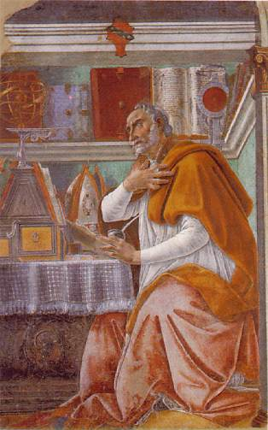
St Augustine
354-430
Bishop of Hippo often regarded as the greatest theologian between Paul and Calvin. Augustine, among other things, battled Pelagius over the issues of sin and grace.
Augustine

Slide 89
“Command what you will, but give what you command.”
-St. Augustine
Augustine

Slide 90
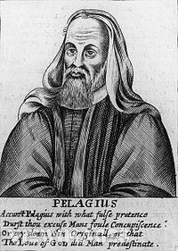
Pelagius
354-420
Believed that man could succeed without the grace of God through his natural ability.
Augustine

Slide 91
Parable of the Boat
Augustine

Slide 92
Council of Orange 529
CANON 1. If anyone denies that it is the whole man, that is, both body and soul, that was "changed for the worse" through the offense of Adam's sin, but believes that the freedom of the soul remains unimpaired and that only the body is subject to corruption, he is deceived by the error of Pelagius and contradicts the scripture which says, "The soul that sins shall die" (Ezek. 18:20); and, "Do you not know that if you yield yourselves to anyone as obedient slaves, you are the slaves of the one whom you obey?" (Rom. 6:16); and, "For whatever overcomes a man, to that he is enslaved" (2 Pet. 2:19).
Augustine

Slide 93
Council of Orange 529
CANON 2. If anyone asserts that Adam's sin affected him alone and not his descendants also, or at least if he declares that it is only the death of the body which is the punishment for sin, and not also that sin, which is the death of the soul, passed through one man to the whole human race, he does injustice to God and contradicts the Apostle, who says, "Therefore as sin came into the world through one man and death through sin, and so death spread to all men because all men sinned" (Rom. 5:12).
Augustine

Slide 94
Council of Orange 529
CANON 3. If anyone says that the grace of God can be conferred as a result of human prayer, but that it is not grace itself which makes us pray to God, he contradicts the prophet Isaiah, or the Apostle who says the same thing, "I have been found by those who did not seek me; I have shown myself to those who did not ask for me" (Rom 10:20, quoting Isa. 65:1).
Augustine

Slide 95
Council of Orange 529
CANON 4. If anyone maintains that God awaits our will to be cleansed from sin, but does not confess that even our will to be cleansed comes to us through the infusion and working of the Holy Spirit, he resists the Holy Spirit himself who says through Solomon, "The will is prepared by the Lord" (Prov. 8:35, LXX), and the salutary word of the Apostle, "For God is at work in you, both to will and to work for his good pleasure" (Phil. 2:13).
Augustine

Slide 96
Field Ops
Arius put human reasoning and understanding above God’s revealed will when he denied the Trinity? How else do we sometime place human reasoning above Scripture?
The Pelagian error was a belief that we did not need God’s grace. How can we commit this same error in other areas of our life?
How does the reality that Christ is fully human change the way you view him? Explain.
Our God is in charge of history. The first doctrine to be discussed, articulated, and matured in the first council was Christ relationship to the Father and the Trinity. What does this say about how God wants to be known?
Orthodoxy

