Slide 1
WELCOME

Slide 2
Bible Boot Camp
Biblical Interpretation

Slide 5
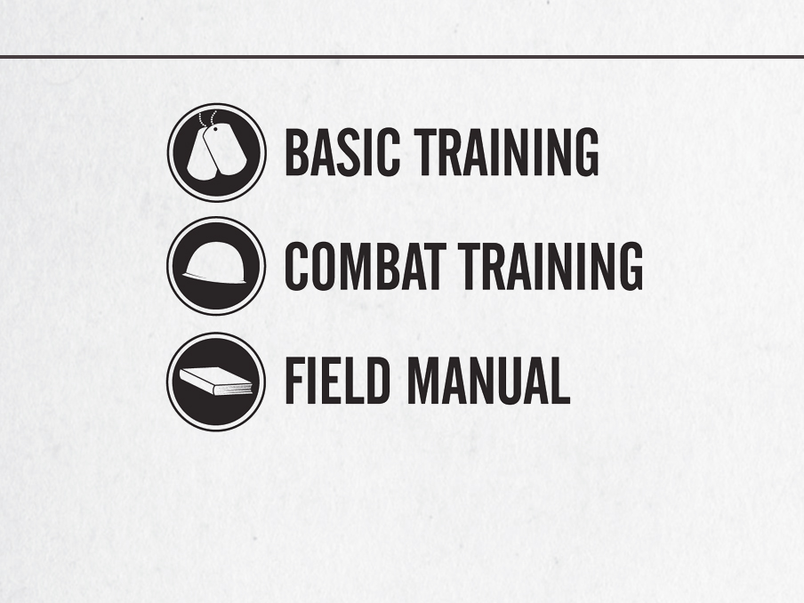

Slide 6
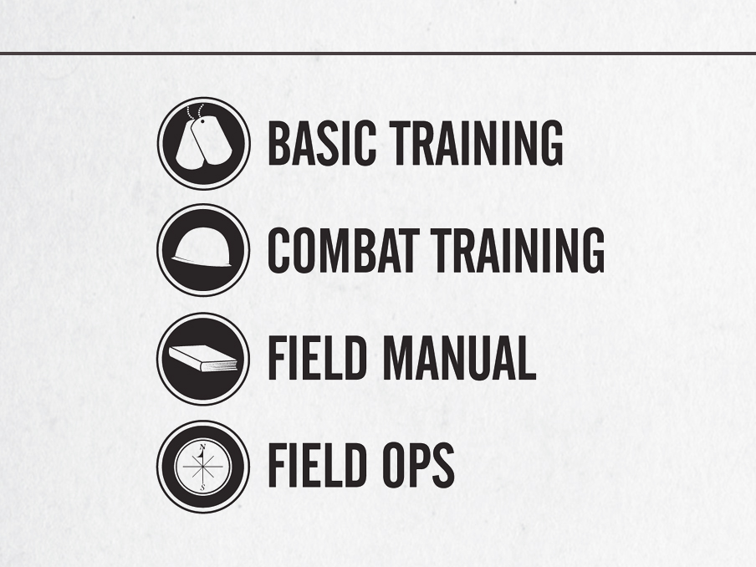

Slide 8
The Interpretive Process
Bridging the Historical Gap
Bridging the Literary Gap
Bringing the Contextual Gap

Slide 9
Some Common Bible Study Methods:
Lucky lotto: (eyes closed) – “I will read this verse”
Brussels Sprout: “Do I have to?”
Channel Changer: “Let’s read something else”
Concord: “Watch how fast I can finish”
Baseball card: “I’m very picky”
Clint Eastwood: “I don’t need anyone’s help”
Magical: “Abracadabra . . . It applies to my life”
Indiana Jones: “Let’s find the hidden meaning”

Slide 10
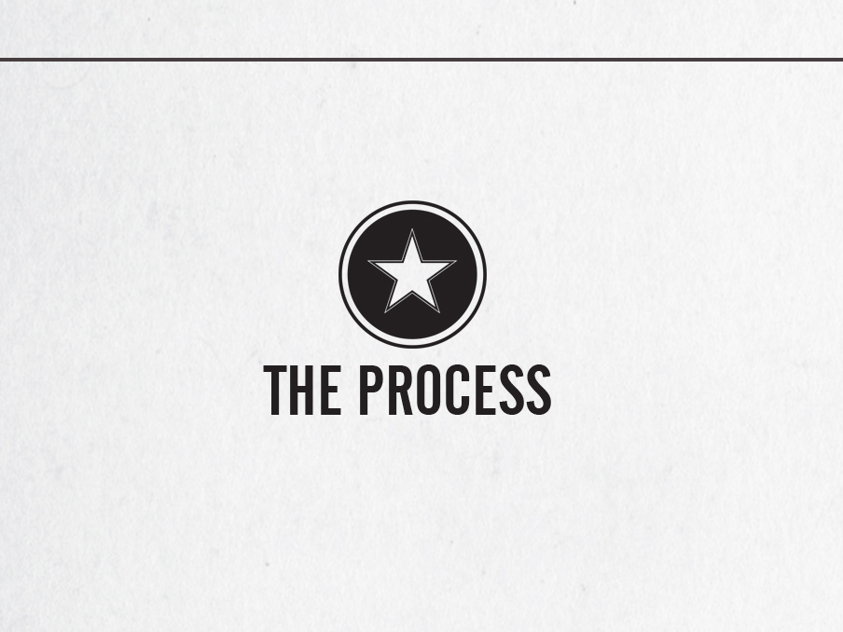
The Process

Slide 11
Basic Training
Exercise illustration
Notes:
Presentation Notes:
This illustrates the importance of a proper method of interpretation.

Slide 12
Interpretation: The process by which the Scriptures are understood by the reader.
Hermeneutics: The theory, method, or rules of biblical interpretation.
Exegesis: Gk. ex, “out” + hēgeisthai, “to lead.” The process of discovering the original meaning of the biblical text by studying the text according to the authorial intent in its historical contexts.

Slide 13
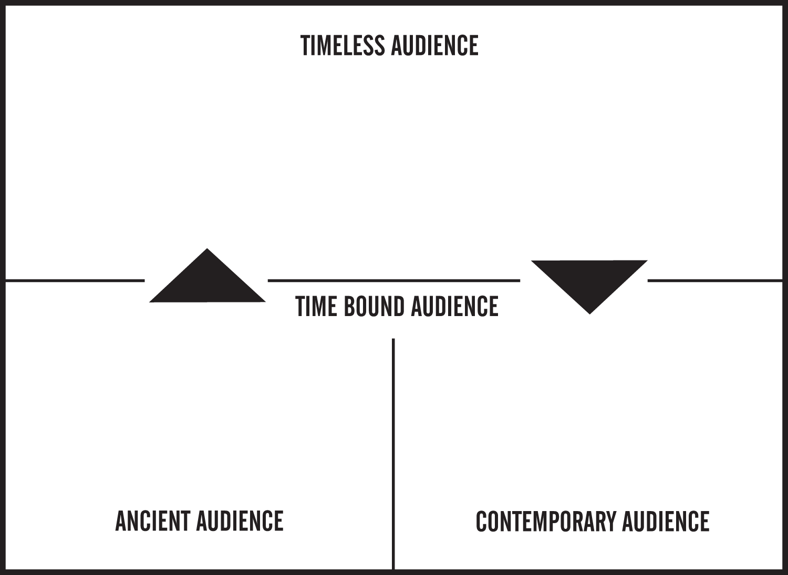
Notes:
Presentation Notes:
Be sure to draw attention here to the three audiences involved.

Slide 15
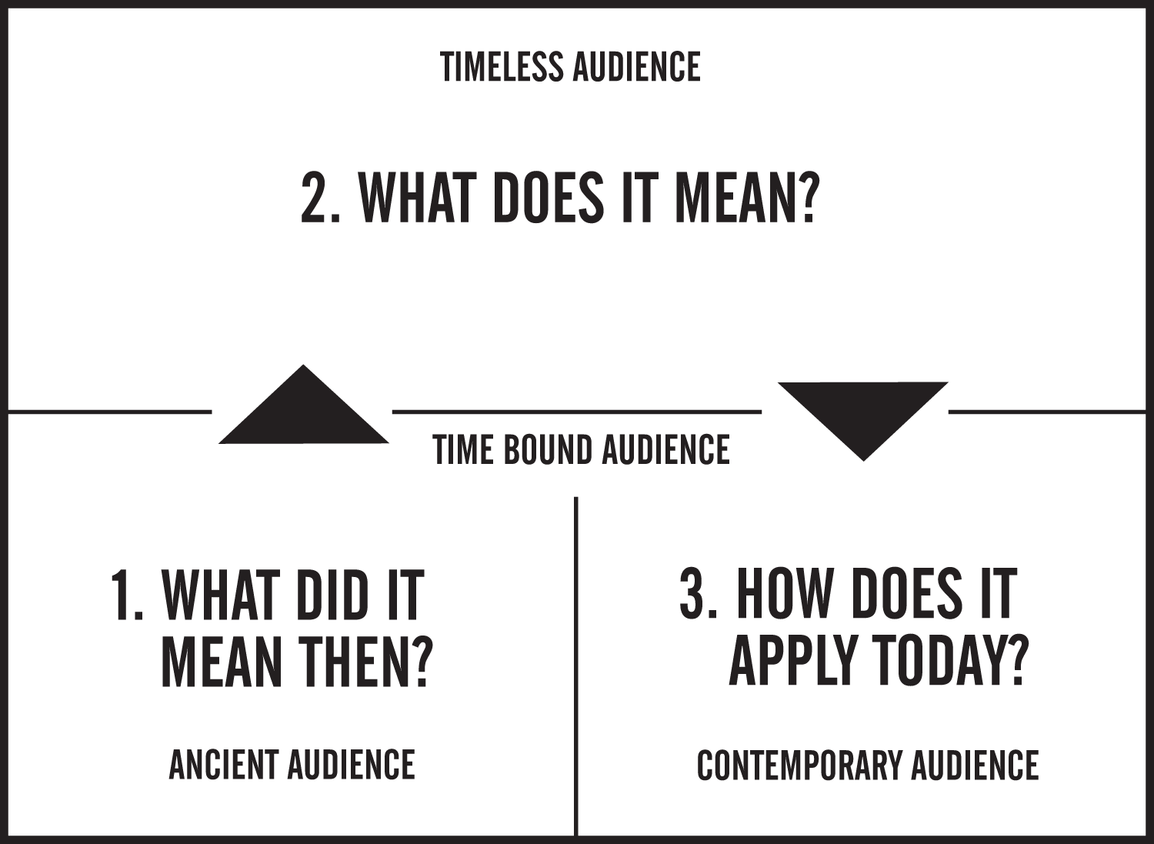

Slide 16
Author's Intent
Author's Intent

Slide 17
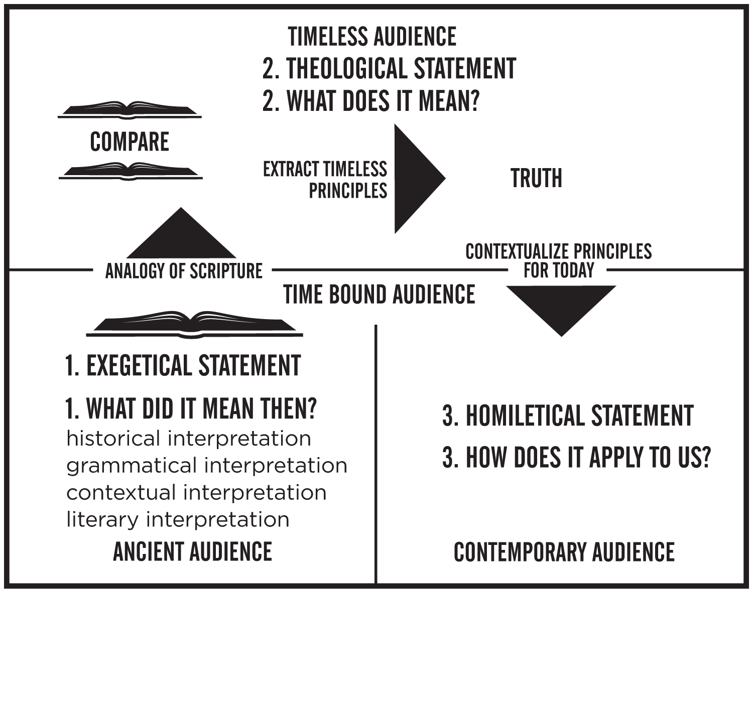
Author's Intent
Author's Intent

Slide 18
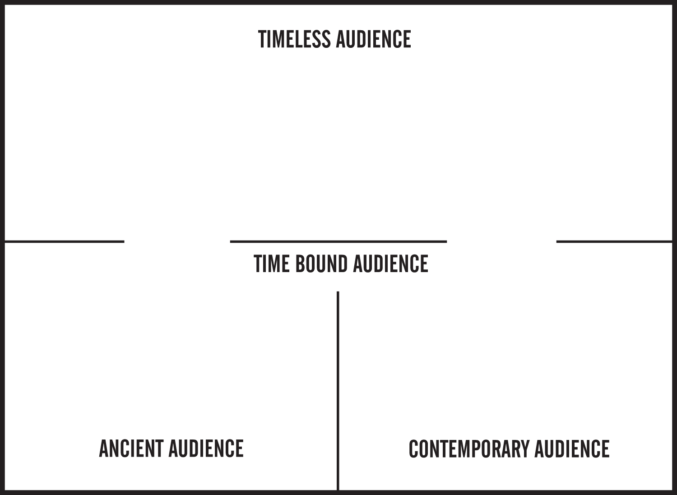
Naked
Clothed
Clothed

Slide 19
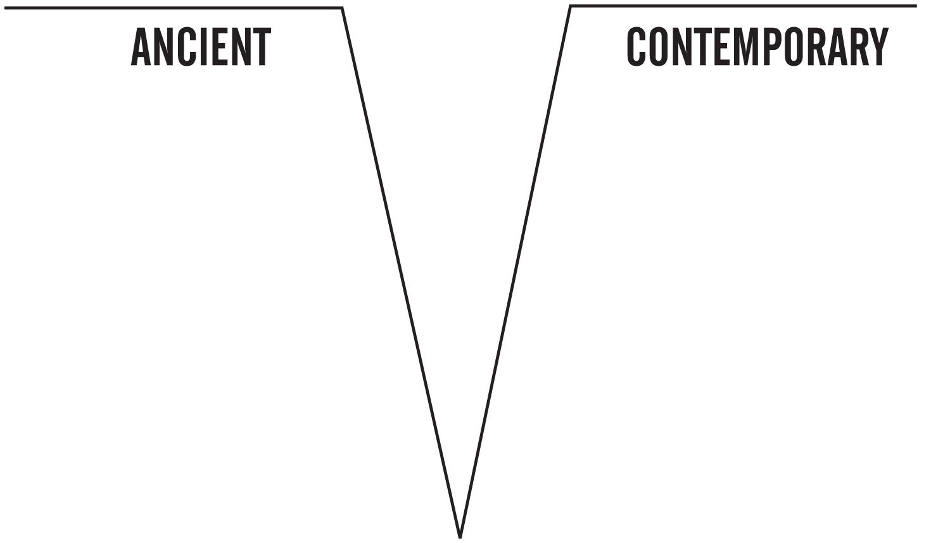
History/Culture
Literature
Context
Grammar

