Slide 2
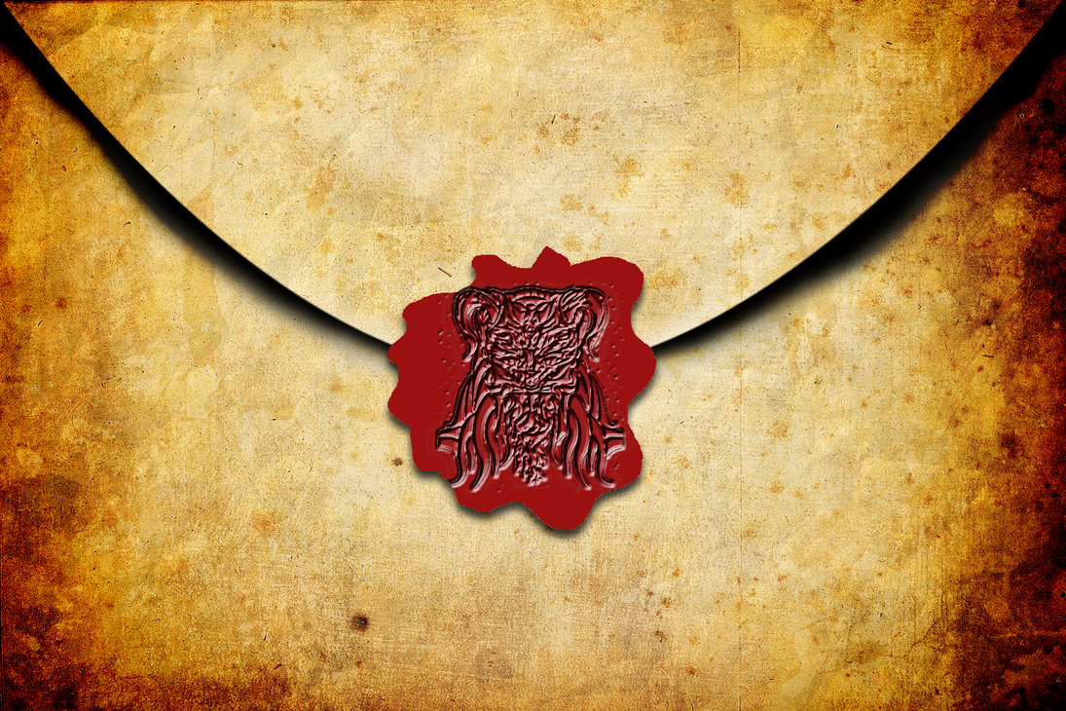
Introduction
1095 Alexis I
to
Urban II

Slide 3
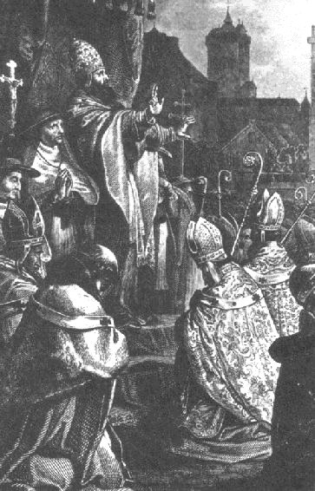
Introduction
Pope Urban II preaches at Clermont

Slide 4
Introduction
Crusades (1095-1291)
Military expeditions in the Christian west in attempts to aid the Christian East and recapture Jerusalem from Islamic invaders.

Slide 5
Introduction
Bad Press for the Crusades:

Slide 6
Introduction
President Clinton,
2001 Georgetown University:
“When the Christian soldiers took Jerusalem [in 1099], they . . . proceeded to kill every woman and child who was Muslim on the Temple Mount. [There were] soldiers walking on the Temple Mount with blood running up to their knees. [This story] is still being told today in the Middle East and we are still paying for it.”

Slide 7
Introduction
Popular History Textbook:
“The Crusades fused three characteristic medieval impulses: piety, pugnacity, and greed. All three were essential.”
Warren Hollister, J. Sears McGee, and Gale Stokes, The West Transformed: A History of Western Civilization, vol. 1 (New York: Cengage/Wadsworth, 2000), 311.

Slide 8
Introduction
R. Scott Peoples
“The soldiers of the First Crusade appeared basically without warning, storming into the Holy Land with the avowed—literally—task of slaughtering unbelievers . . . The Crusades were an early sort of imperialism”
Crusade of Kings (Rockville, MD: Wildside, 2009), 7

Slide 9
Introduction
Sir Steven Runciman:
“[The Crusades were] nothing more than a long act of intolerance in the name of God, which is the sin against the Holy Ghost.”
Sir Steven Runciman, A History of the Crusades: Vol. III, The Kingdom of Acre and the Later Crusades (Cambridge: Cambridge University Press, 1954), 480

Slide 10
Introduction
Voltaire:
“An epidemic of fury which lasted for two hundred years and which was always marked by every cruelty, every perfidy, every debauchery, and every folly of which human nature is capable.”

Slide 11
Introduction
In 1999, the 900th anniversary of the sacking of Jerusalem by the Crusaders, the New York Times compared the Crusades to Hitler’s atrocities. That same year hundreds of Protestants walked in a pilgrimage to the Holy Land wearing T-shirts emblazoned with the words "I apologise" in Arabic.

Slide 12
Introduction
“Remember that during the Crusades and the Inquisition, people committed terrible deeds in the name of Christ. “
President Obama, 2015

Slide 13
Introduction
“ The Crusades were kind of an equal battle between two groups of barbarians, the Muslims and the crusading barbarians.”
New York City Mayor Rudy Giuliani

Slide 14
Introduction
“Crusade” means “Cross”

Slide 15
Introduction
Billy Graham Crusades
Campus Crusade for Christ is now “Cru”

Slide 16
Introduction
Misconceptions about the Crusades:

Slide 17
Introduction
1. The Crusades where unprovoked attacks

Slide 18
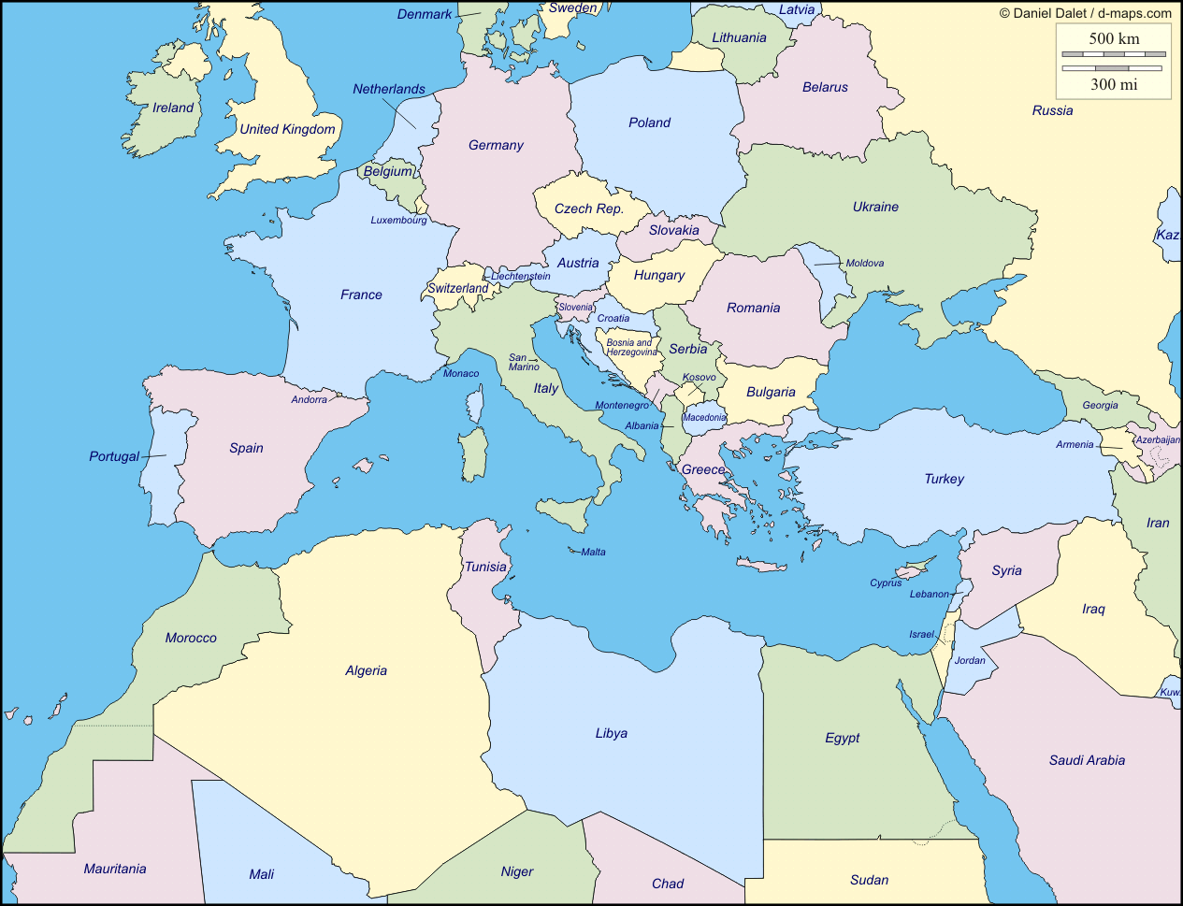

Slide 19
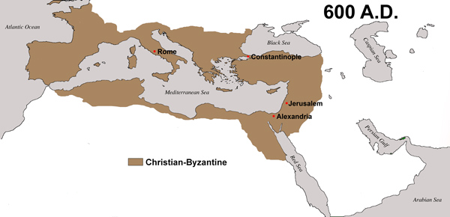

Slide 20
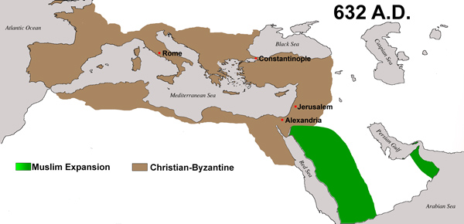

Slide 21
Introduction
638 Jerusalem fell to the Muslims.
691 Dome of the Rock completed.

Slide 22
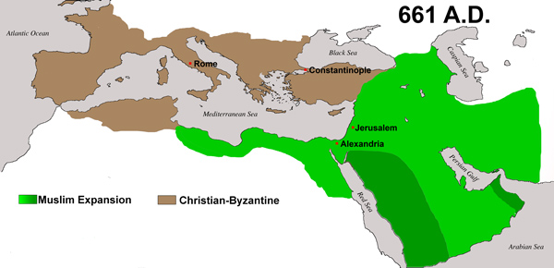

Slide 23
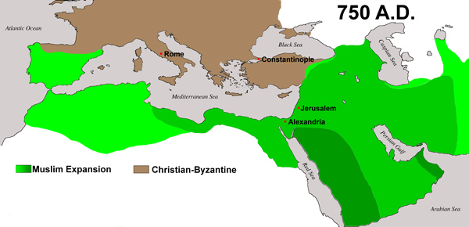

Slide 24
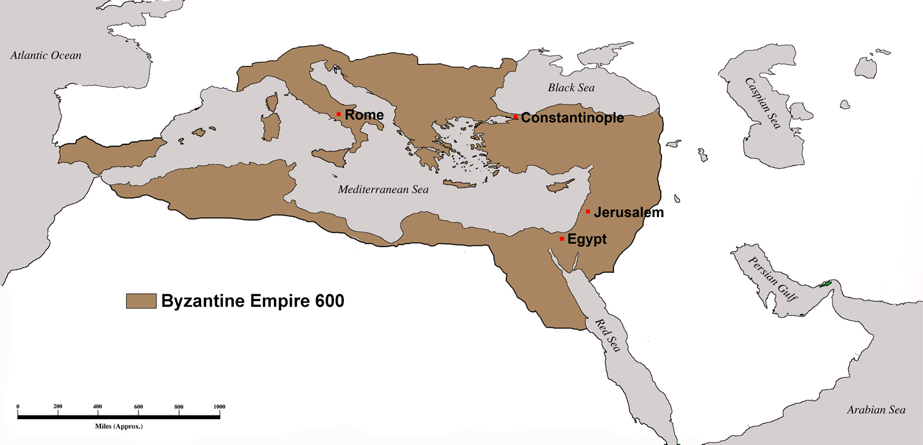

Slide 25
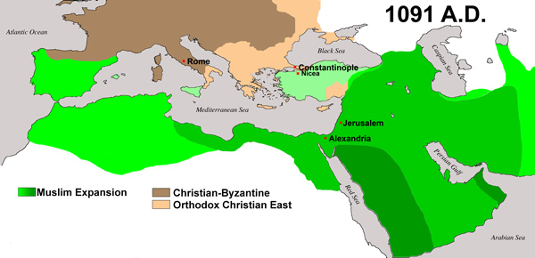

Slide 26
Introduction
Muslims had been on a conquest of the Eastern Empire for over five-hundred years.
Two-thirds of the formerly Christian world was now ruled by Muslims.
Muslim pirate camps were set up all over threatening the East and the West.
They were threatening southern France and Italy.

Slide 27
Introduction
1009, a mentally deranged Muslim ruler, Abu ‘Ali Mansur, destroyed the Church of the Holy Sepulchre.
He ordered the destruction or confiscation of 30,000 churches.

Slide 28
Introduction
1071, the Byzantines Empire suffered a devastating defeat at Turkish hands in the battle of Manzikert. The Christians lost control of almost all of Asia Minor, with its agricultural resources and military recruiting grounds.
A Muslim sultan set up a capital in Nicaea, site of the creation of the Nicene Creed in a.d. 325 and a scant 125 miles from Constantinople.
Constantinople began to call on Rome for help.

Slide 29
Introduction
“I was ordered to fight all men until they say ‘There is no god but Allah.’”
-Mohammed

Slide 30
Introduction
“This is not the absence of provocation; rather, it is a deadly and persistent threat, and one which had to be answered by forceful defense if Christendom were to survive. The crusades were simply one tool in the defensive options exercised by Christians.”
-Paul F. Crawford

Slide 31
Introduction
2. Western Christians went on the Crusades due to greed and their desire to get rich.

Slide 32
Introduction
Most of the Crusaders had to spend their own fortunes to embark on the Crusades.
Plundering Muslim towns did nothing more than help finance the war. This was never anything out of the ordinary in these days.

Slide 33
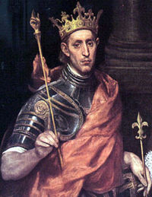
Introduction
Louis IX’s, King of France, Seventh Crusade in the mid-thirteenth century cost more than six times the annual revenue of the crown.

Slide 34
Introduction
Most of the money flow was from the West to the East, not the East to the West.
For most, the Crusades were reason for bankruptcy rather than wealth, which is why indulgences became abused and the Crusades eventually had to stop.

Slide 35
Introduction
3. Crusaders did not really believe in what they were crusading for.

Slide 36
Introduction
Most Crusaders did not return home (75%), but died in battle or on the journey. Why die for something you did not believe in?
Crusaders were not drafted.
Death in a Crusade was considered martyrdom.

Slide 37
Introduction
Peter the Hermit
Popular “Crusade sermons” directed people’s attention to the need of their brothers and sisters, the defamation of the Holy Land, and the eternal rewards.

Slide 38
Introduction
4. The Crusade are a big reason for Muslim hostility today.

Slide 39
Introduction
Muslims did not mention or care about the history of the Crusades until the 20th century when they lost Jerusalem.
The first Muslim history of the Crusades was not published until 1899.

Slide 40
Introduction
Muslims are now more motivated by the opinions of the liberal historic revisionists in the Western World than their own views.
Protestants have helped fuel the fire by blaming a corrupt institutional church led by the Pope.
Osama Bin Ladin used Western revisionist opinion about the Crusades to fuel his Jihad.

Slide 41
Introduction
1095 Alexis I
to
Urban II

Slide 42
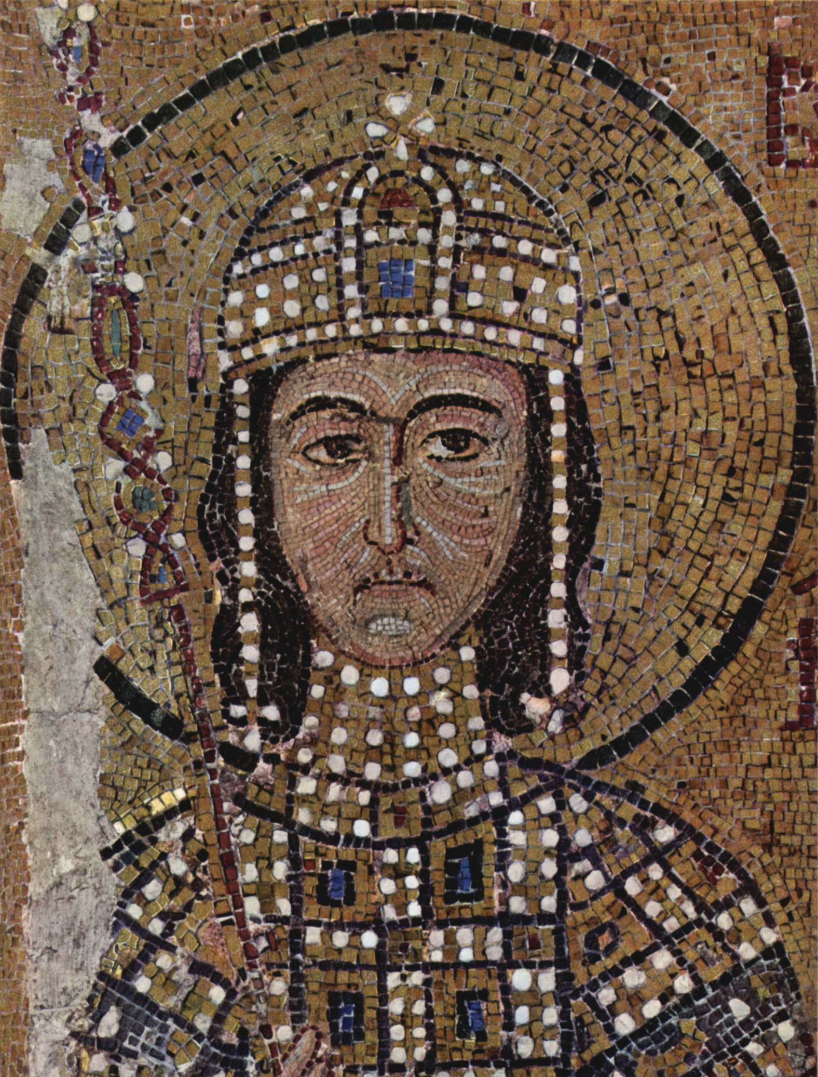
Introduction
Alexios I Komnenos

Slide 43
Introduction
Pope Urban II preaches at Clermont
Nov. 27, 1095

Slide 44
Introduction
“Your brethren who live in the east are in urgent need of your help, and you must hasten to give them the aid. The Turks and Arabs have attacked them and have conquered the territory of Romania [the Greek empire] as far west as the shore of the Mediterranean. They have killed and captured many, and have destroyed the churches and devastated the empire”
Pope Urban II

Slide 45
Introduction
“On this account I, or rather the Lord, beseech you as Christ's heralds to publish this everywhere and to persuade all people of whatever rank, foot-soldiers and knights, poor and rich, to carry aid promptly to those Christians and to destroy that vile race from the lands of our friends. Christ commands it. “
Pope Urban II

Slide 46
Introduction
"All who die by the way, whether by land or by sea, or in battle against the pagans, shall have immediate remission of sins”
-Pope Urban II

Slide 47
Introduction
“Let those who for a long time, have been robbers, now become knights. Let those who have been fighting against their brothers and relatives now fight in a proper way against the barbarians. Let those who have been serving as mercenaries for small pay now obtain the eternal reward. Let those who have been wearing themselves out in both body and soul now work for a double honor.”
-Pope Urban II

Slide 48
Introduction
“Let hem eagerly set out on the way with God as their guide.”
-Pope Urban II

Slide 49
Introduction
“Deus vult! Deus vult!”

Slide 50
Introduction
“God wills it! God wills it!”

Slide 51
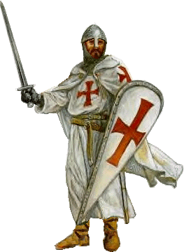
Introduction
The Crusades were expeditions undertaken, in fulfillment of a solemn vow to deliver the Holy Places from Muslim tyranny.

